Slide 1
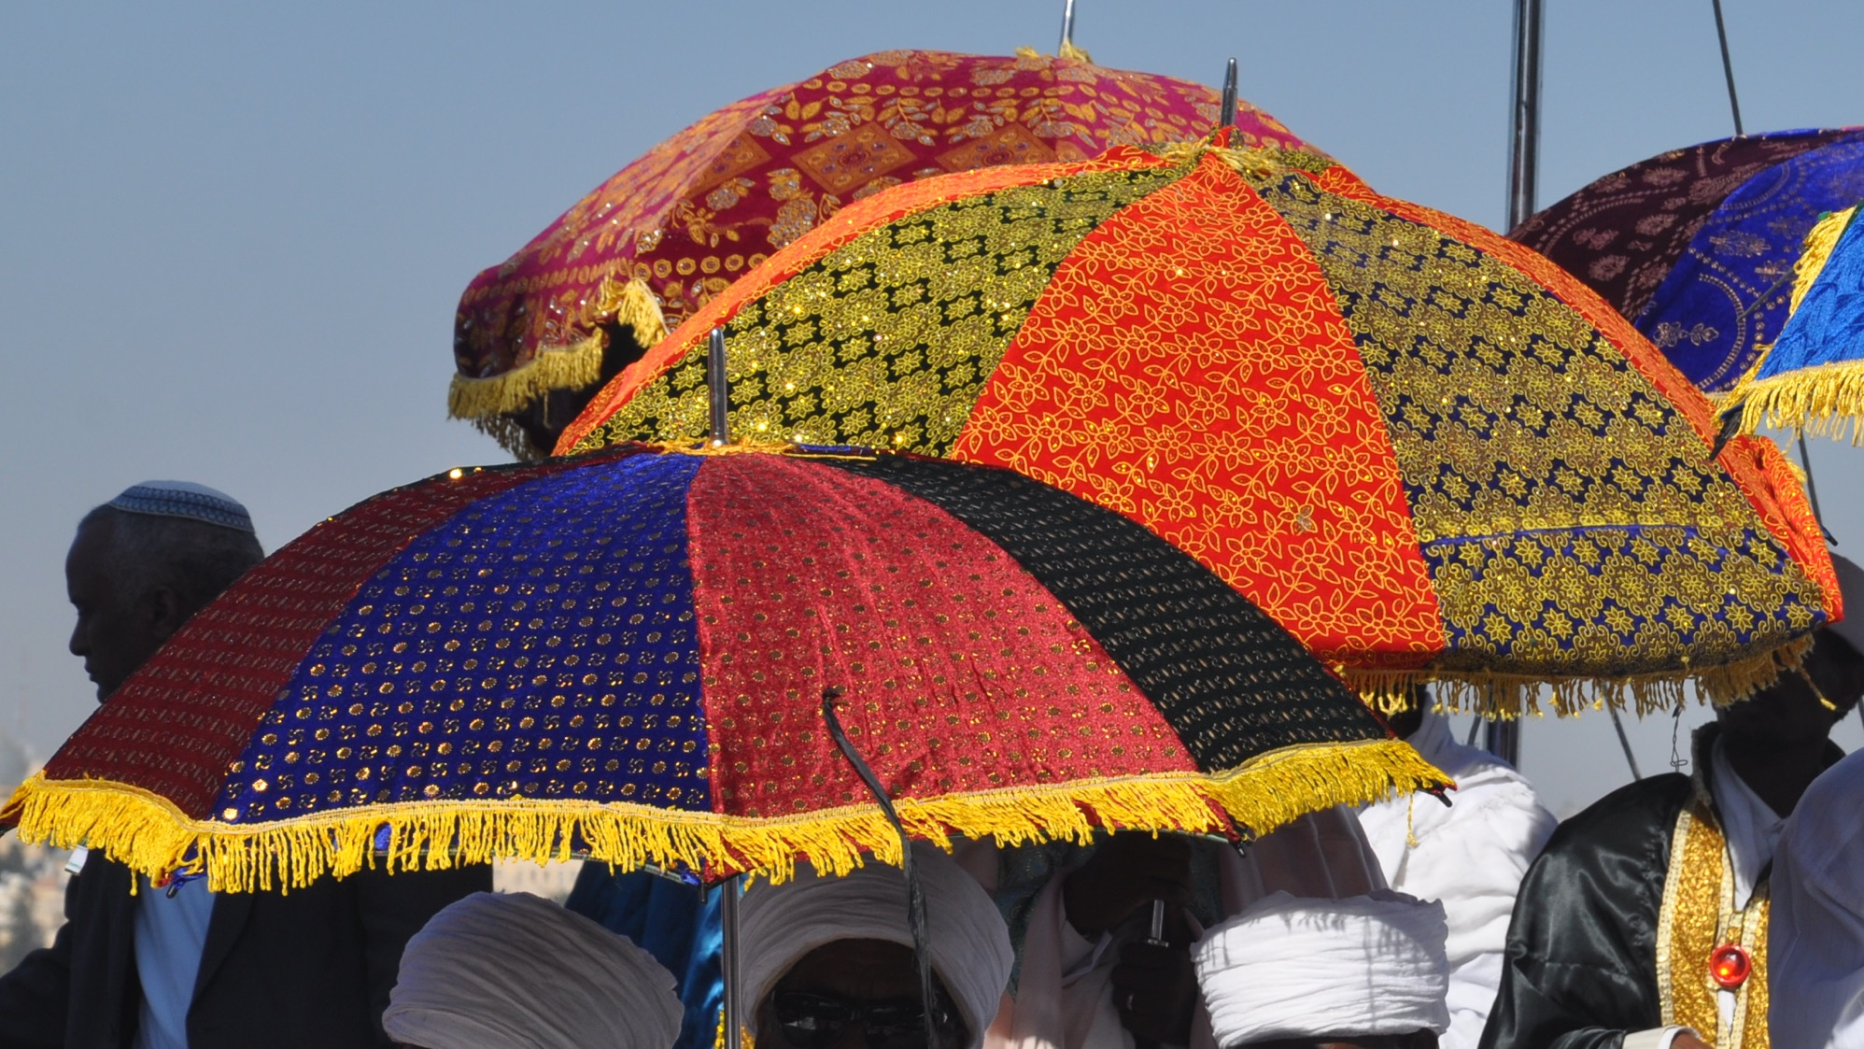



How do we bring the holiday back to our community?

