Slide 1
Beta Israel
Celebrating Sigd
A Jewish biblical holiday
@Pnina Agenyahu

Slide 2
The Jewish life in Ethiopia:
Orit - (tora) The holy book was the main guide for Jewish life.
Ethiopian Jews didn’t recognize the Mishnah and the Talmud.
Spiritual and Religious Leadership - Kesim (Kes –one
Tumah and Taharah - being ritually "impure" and "pure"
Jewish Holidays from the Torah only.
The first month is Nisan.

Slide 3
Jewish Ethiopian Holidays:
Birehan Serek (sunrise holiday light) this holiday celebrated 10th of Tishrei, which are reminiscent of the creation of the world is also the New Year which celebrated by the Jews of Europe and Islamic countries on the same day states the beginning of humanity.
Rosh Hodesh prayers and festival meal, no one works.
Sigd celebrated on the 29th of Cheshvan is one of the most prominent expressions of the unique culture of Ethiopian Jews.

Slide 4
The Sigd Holiday
The Origin of the holiday
“Ezra opened the book in the sight of all the people- for he was above all the people and when he opened it, all the people stood up. And Ezra blessed the Lord, the great God, and all the people answered ; ”Amen Amen” with the lifting up of their hands ;and they bowed their heads and fell down before the Lord with their faces to the ground”. (Nehemiah 8:5-6)
Other tradition claims also that:
After many Jews were killed in many long wars in the early 6th century King Gideon marked the end of hostilities as a special day of thanksgiving to god for the miracles he did for the Jews.
The holiday was determined by the kessim and monks in the 15th century during a period of severe persecution.
The holiday was established in the 15th century as part of Abba Sabra to keep beta Israel committee separate from the Christians.

Slide 5
Five significant points about Sigd:
Remember the receiving of the Torah & strengthening the relationship of the Jews with the Torah.
Renewing the Covenant with God as they did in the days of Ezra.
Encouraging the community to preserve Jewish identity.
Fasting day of repentance and prayer.
Creating unity in the community.

Slide 6
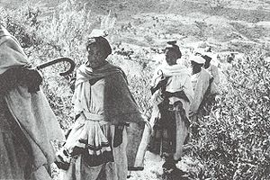
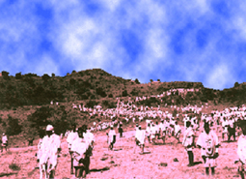
Sigd in Ethiopia
Preparation - everyone goes to the largest village beautifully dressed after immersing in the mikveh. Sheep & beef are cooked the day before for the holiday meal for after the fast.
Choosing a mountain to ascent for the ceremony
On the day of Sigd -The evening before there are prayers, in the morning they immerse in the river and go to the tall mountain together with the kessim. Some put rocks on their heads to symbolize their heavy sins. At the ceremony the laws of the Torah are read, and they repent for their sins while raising their arms asking God to listen to their prayers.

Slide 7
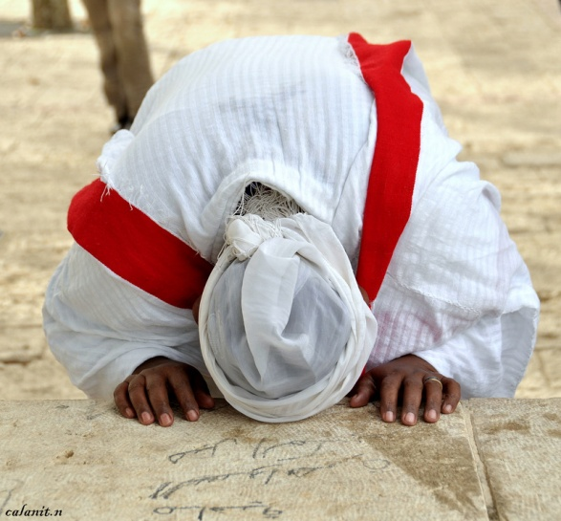
Sigd in Israel
The ceremony take place at Armon Hanazhiv in Jerusalem
On 30.06.2008, the Knesset passed a law that this holiday, become part of the Jewish calendar. uploaded by MK Uri Yehuda Ariel from the National Union, in cooperation with MKs from Shas, Meretz, Labor and Likud.
The law states that:
Special holiday is noted by the state on 28th Cheshvan
Central rally will be organized by the Ministry of culture
Educational activities for Sigd holiday will be provided
by the Minister of Education.
A day of choice.

Slide 8
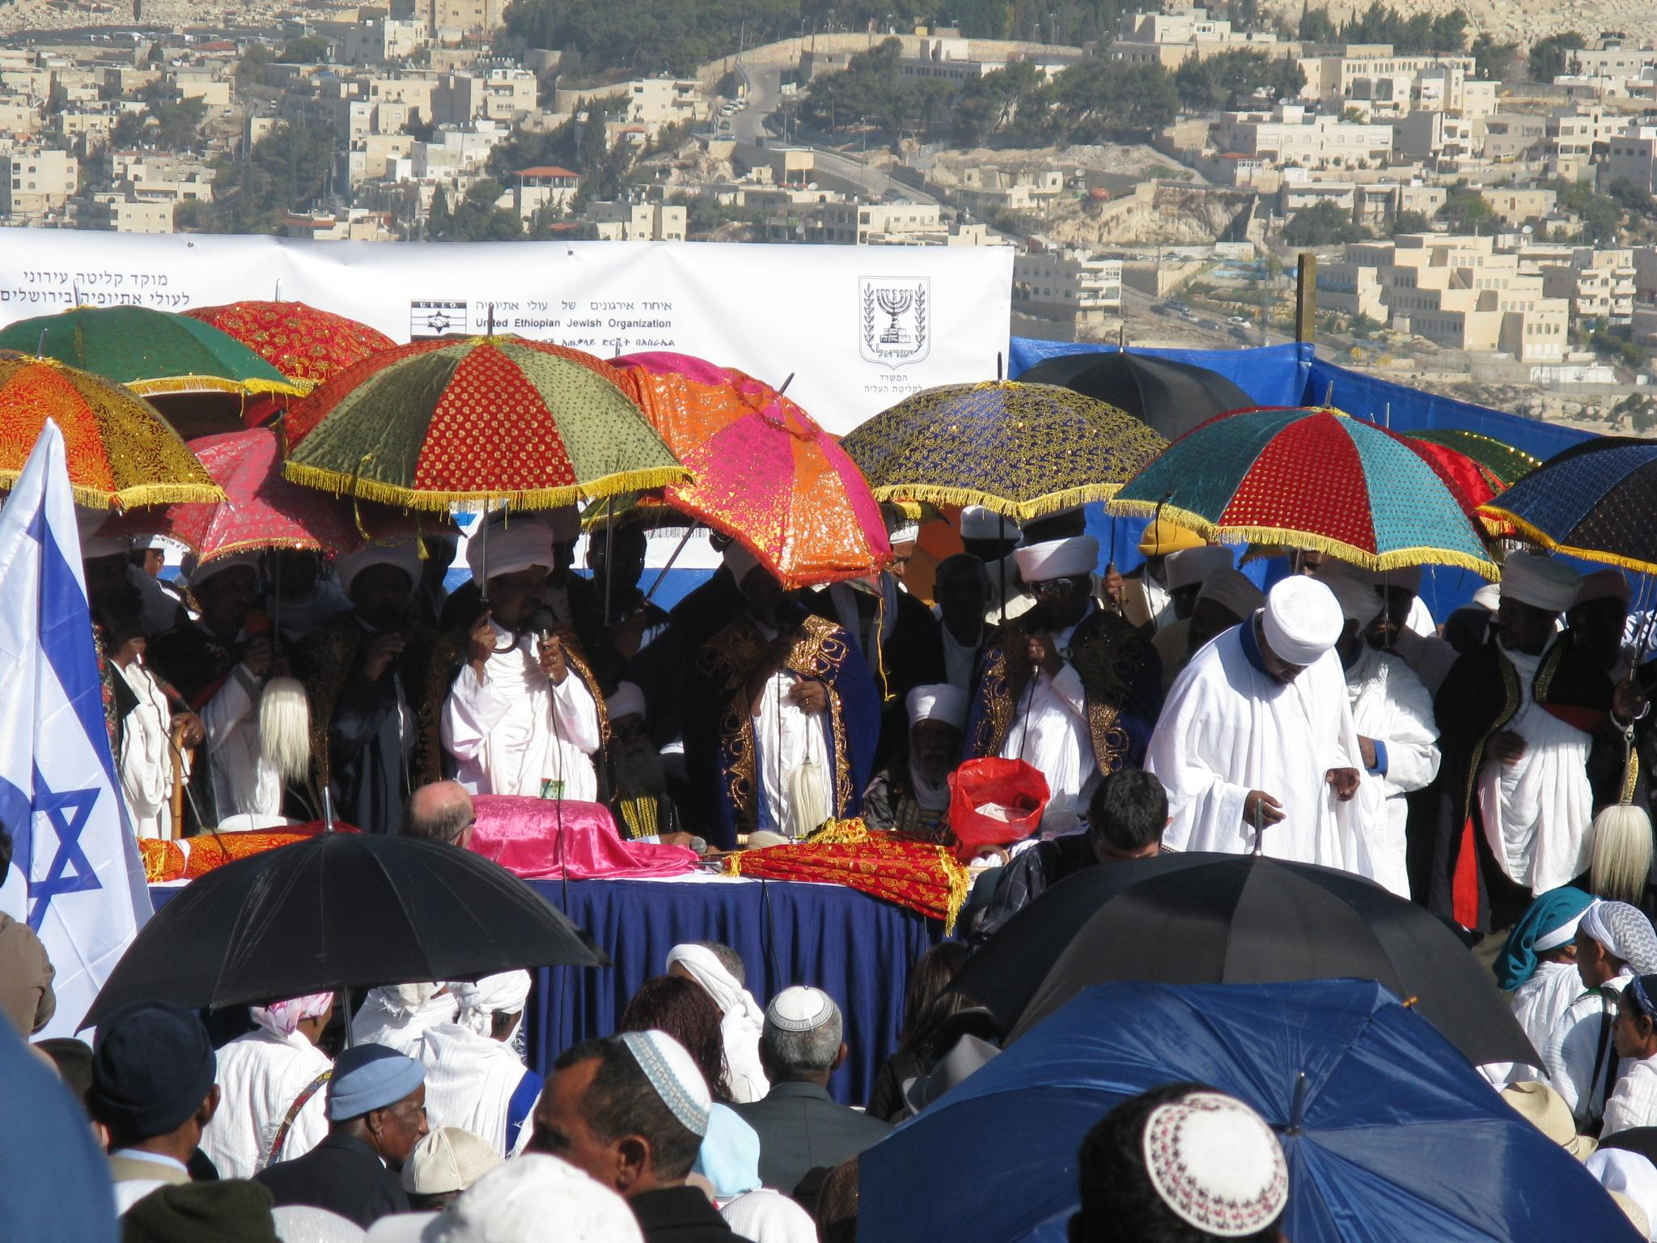
Ethiopian Rabbis blessing the audience at the Sigd celebration. (Armon Hanazhiv, Jerusalem)

Slide 9
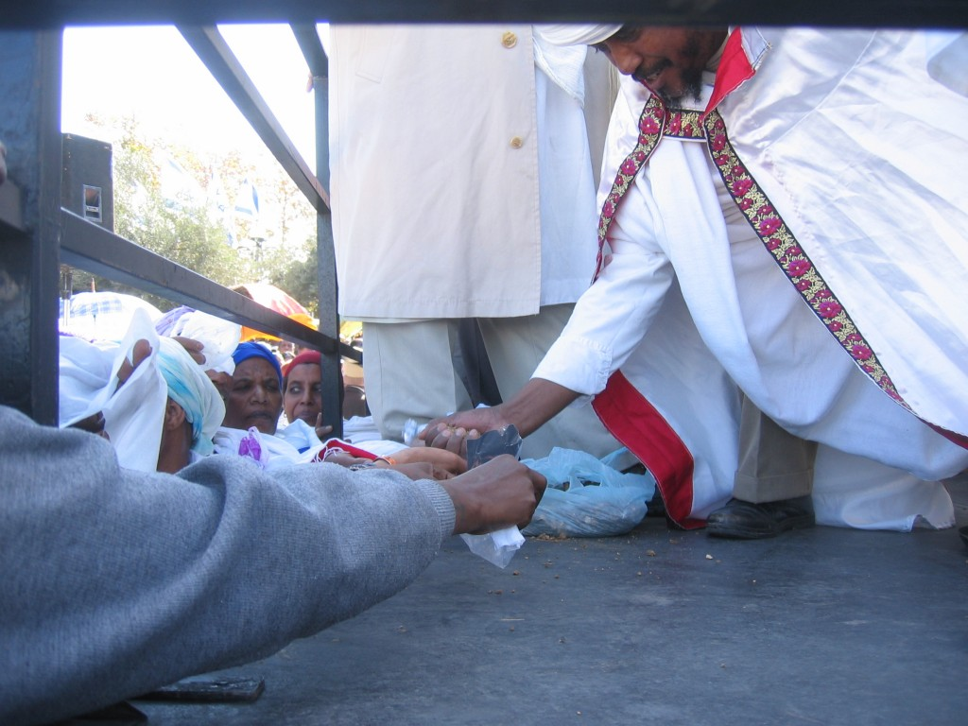
Distribution of blessed bread

Slide 10
At the conclusion of the ceremony were squatting on their knees bowing down and were saying:
"As we got to the holiday this year so we will have it next year in Jerusalem.“

Slide 11
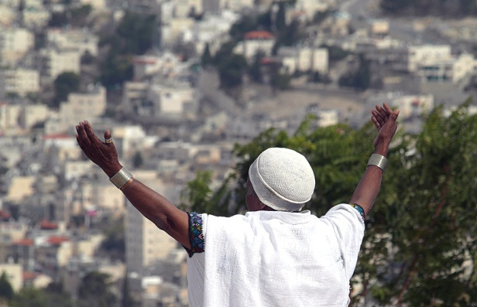
Sigd relevant for world Jewry
Social motive
Combined of unique traditions of smaller groups is a key part of the diversity of Jewish people
Jewish Value
longing yearning for Jerusalem is still a significant component for Jews living in the world

