Slide 1
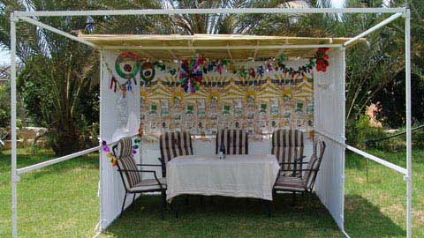
Hospitality

Slide 2
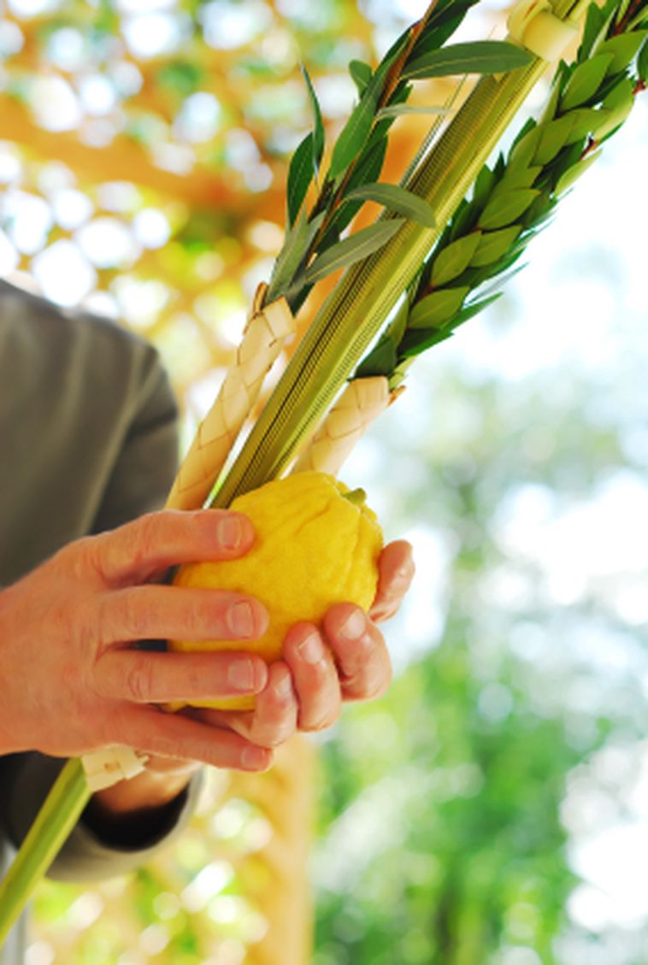
Sukkot holiday mitzvah
Don’t work
Sit in the sukkah all the holiday
be happy (Simchat Torah)
Host people in the sukkah
The four species: Lulav etrog, hadas and arava

Slide 3
Hospitality is an important value in different cultures regarding hosting a person who has come to a foreign place.
The hospitality has different meanings in different places in the world.

Slide 4
In the Jewish tradition
Hospitality is an important commandment that the Talmud states.
In some cases, it is possible to not do the standard law for hospitality.
It’s very important- When guests leave the house you need pack them water and food for the way.
It is commanded to accompany the guests on the way
In fact, the Talmud states that the wages given on the escort are even greater than the wages themselves.

Slide 5
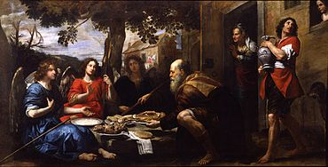
Hosting value in the Torah -
The story of Abraham
Its been told on the Torah that Abraham was sick (because three days ago he made circumcision) he was sitting and waiting for gusts. It was very hot…
On that day three mans came to his house, Abraham and his wife Sara worked so hard to take care of them. Those 3 mans where angels that god was sending to him to tell about the Sara’s pregnancy.
Abraham is the Character that most recognized with the hosting value.

Slide 6
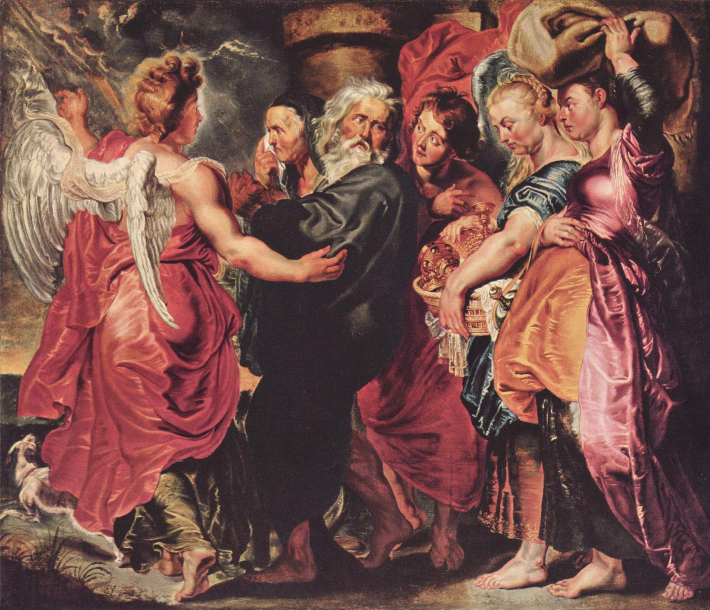
The story of Lot
Another character in the book of Genesis associated with hospitality is Lot.
In order to revolutionize Sodom and Gomorrah, God sends two angels to the city, and apparently these are two of the three "people" who met with Abraham at the door of the tent in chapter 18
Lot waiting on city gates and meets them.
Although they express their desire to stay in the street - he insists on his going to his home.
The wicked city men demand that they bring their guests out - probably for the purpose of rape. Lot protects his guests, exits his body to the crowd gathering around his house, and even offers his daughters the place of guests.

Slide 7
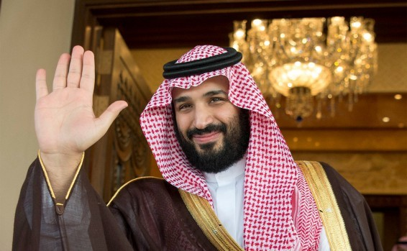
The Muslim hosting Tradition
The Bedouin, the residents of the desert, are famous for their hospitality.
According to tradition, the Muslim is obliged to host every person, no matter who they are, to serve the guest well

Slide 8
if you are going to a tradisional Muslim house you need to know…
The host can’t ask you questions for Three days (why did you come? Where are you going?)
The guest must revile why he came only after those days.
There is a special place in the house for hospitality,
the guest needs to avoids meeting the women of the house.

Slide 9
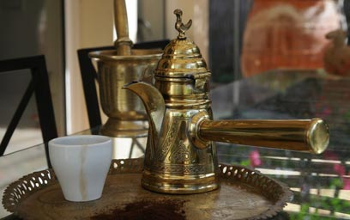
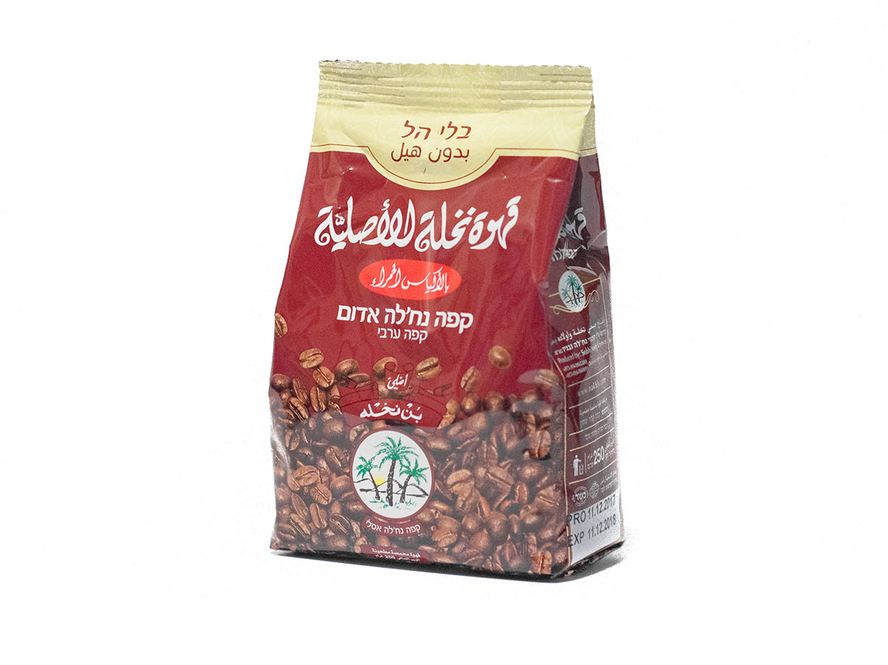
A fancy custom is to shed flock on the first day in honor of the guest. On the rest of the day the guest eats what the hosts eat.
Drinking coffee with the guest is a special event. It is common to drink the coffee in small sips and at the end of the drink hand the cup over to the host. You can drink one or two cups of coffee but avoid drinking a third cup of coffee.

Slide 10
The guest won’t eat without being invited by the host to eat.
even the simplest food such as: a piece of fruit or bread. The host will not eat a slice of bread without inviting his friends, or the strangers who are with him.

Slide 11
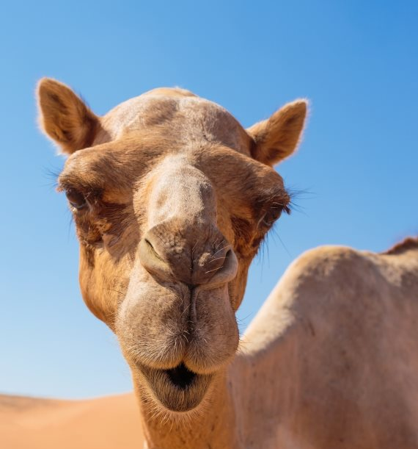
The host must also take care of the visitor's riding beast
The guest can’t ask for anything, the host needs satisfies all his all needs even without asking.
The only requests that are allowed are to ask where is Mecca so that he can direct it in his prayer and ask where’s the bathroom.

Slide 12
The guest should request permission to leave.
The guest should express his sorrow of going and thank the hospitality and respect.
The guest must invite the hosts to his home.
On the other hand, the hosts also express their regret that the guest is leaving them and that they would like to spend more time with them.

Slide 13
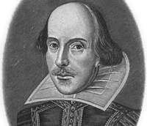
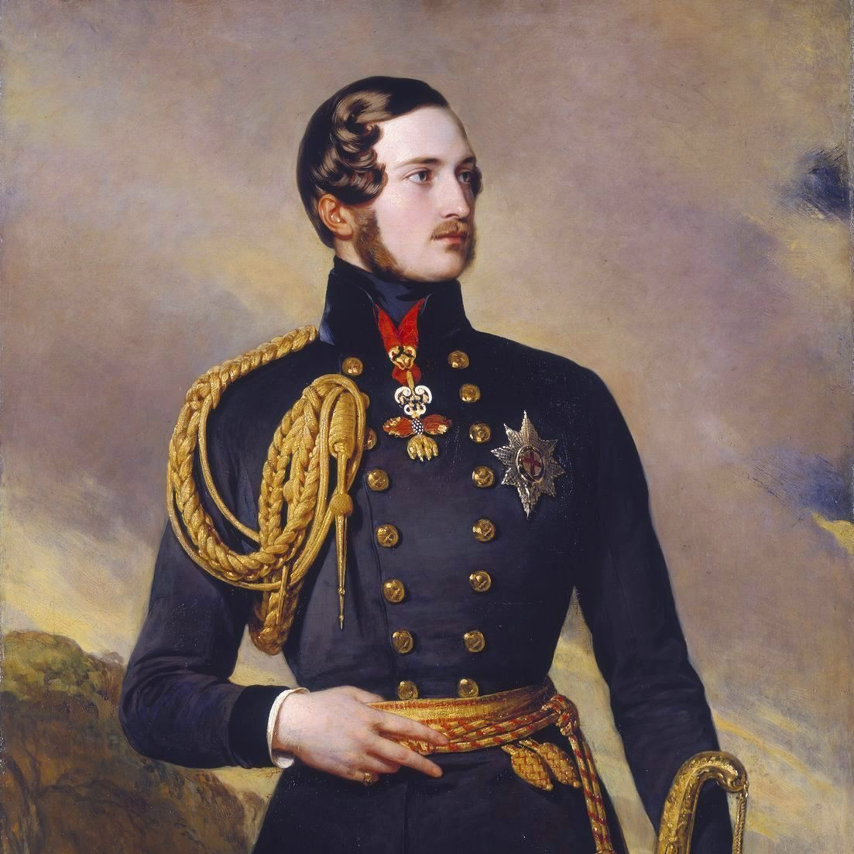
An Arabic poem about hospitality
When he comes, he is a Prince (Amir)
During his stay he is a prisoner
When he leaves, he is a poet

Slide 14
Hospitality in Christianity
Hospitality, hostilities, is one of the seven acts of grace in the Christian religion. Calls the commandments of the love of others.

Slide 15
And something about the Israelis…
Israel Trail –
Angels Trail: People can stay with them, leave food on the way ..
Feeling of a community – knocking on doors.

Slide 16
"fish and Guests stink after 3 days" known Israeli proverb

