Slide 1
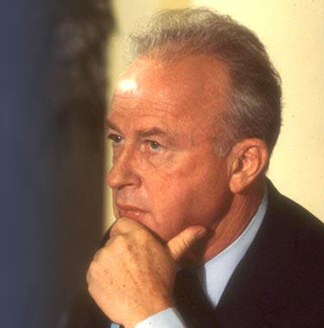
Following Golda Meir's resignation on April 1974, Rabin was elected party leader.

Slide 2
In 1992 Rabin was elected as chairman of the Labor Party. his party, strongly focusing on the popularity of its leader, managed to win a clear victory over the Likud of incumbent Prime Minister Yitzhak Shamir.

Slide 3
Rabin played a leading role in the signing of the Oslo Accords, which created the Palestinian National Authority and granted it partial control over parts of the Gaza Strip and West Bank.

Slide 4
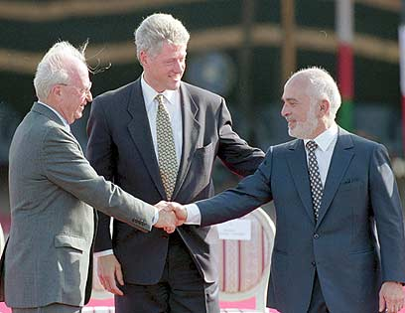
Rabin also oversaw the signing of theIsrael-Jordan Treaty of Peace in 1994.

Slide 6
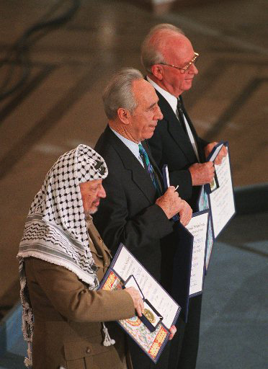
For his role in the creation of the Oslo Accords, Rabin was awarded the 1994 Nobel Peace Prize, along with Yasser Arafat and Shimon Peres.

Slide 7
THAT IS NOT ALL
Meanwhile in Israel …..

Slide 8
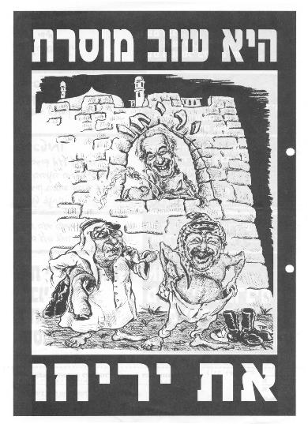

Slide 9
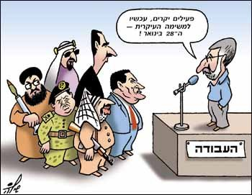
Negotiating with the enemy

Slide 10
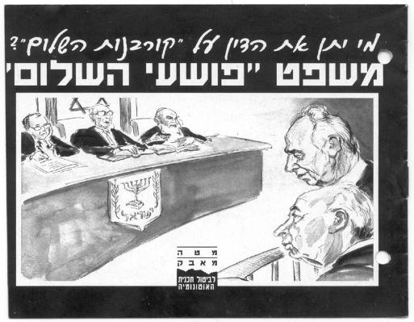
The criminals of “peace”

Slide 11
Instigating-pressuring, or threatening so as to cause another to commit a crime.

Slide 12
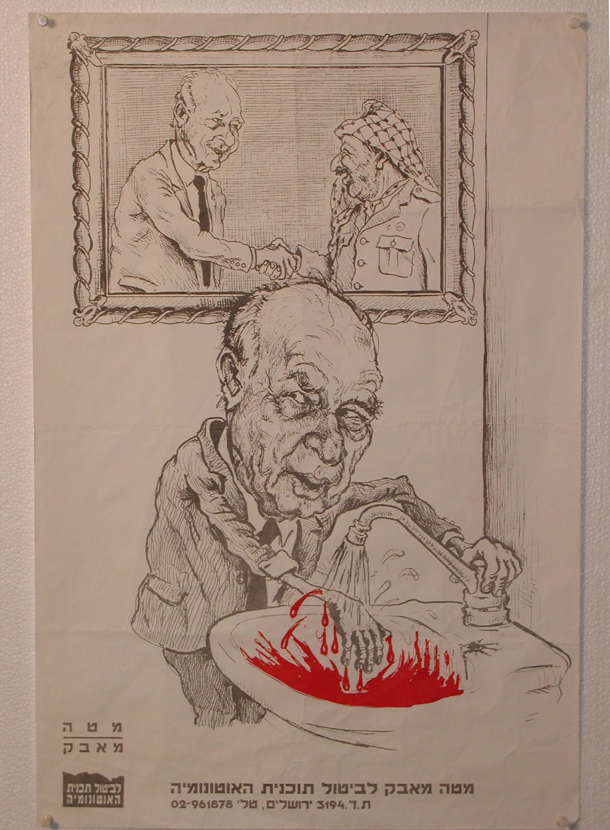
Yitzhak Rabin is presented as a cold blooded killer with blood on his hands after the Oslo Accords

Slide 13
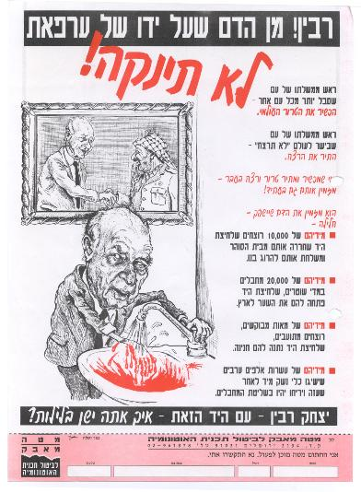

Slide 14
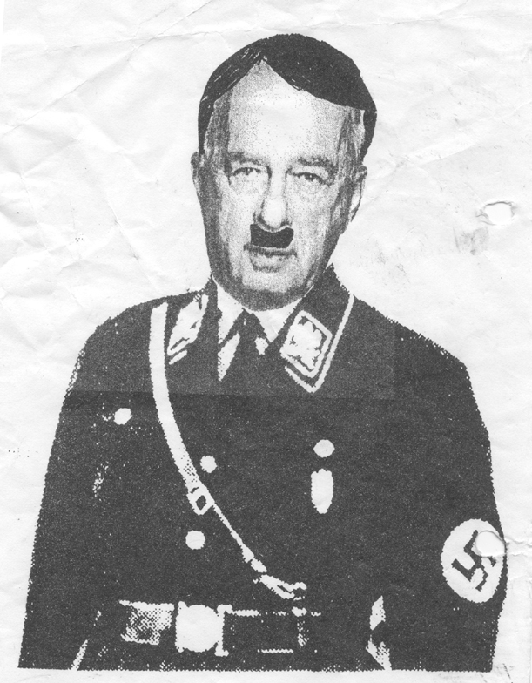
S.S officer

Slide 15
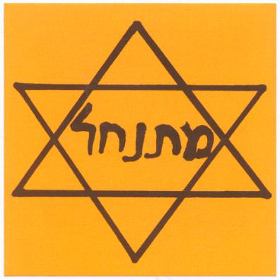

Slide 16
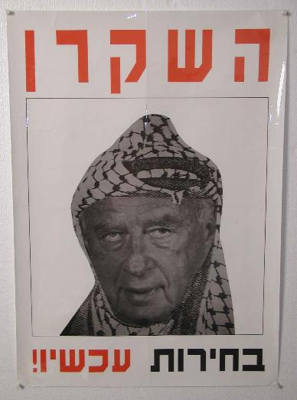
The liar .

Slide 17
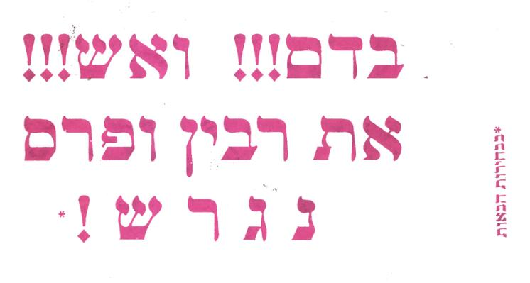

Slide 18
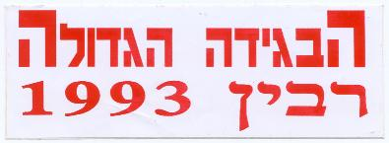
The stabbing in the back Rabin 1993

Slide 19
Violent demonstrating.

Slide 20
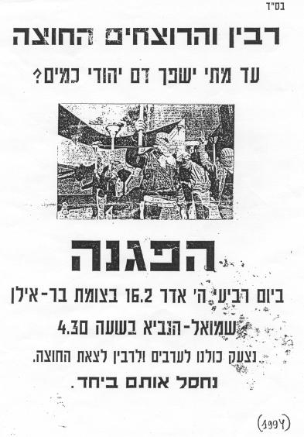

Slide 21
סרט הפגנה

Slide 22
In October 1995, on the eve of Yom Kippur, the Jewish day of atonement, a group of Israelis led by Avigdor Eskin gathered outside the home of Prime Minister Yitzhak Rabin. Wrapped in prayer shawls, they intoned the ancient Aramaic chant Pulsa da-Nura ("Lashes of Fire"), aKabbalistic curse: "I deliver to you, the angels of wrath and ire, Yitzhak, the son of Rosa Rabin, that you may smother him and the specter of him, and cast him into bed, and dry up his wealth, and plague his thoughts, and scatter his mind that he may be steadily diminished until he reaches his death. Put to death the cursed Yitzhak. May [he] be damned, damned, damned!"
After Rabin's assassination one month later--as Israel and the world mourned a great statesman--Eskin boasted of his prowess on Israeli television. The curse worked.
The "lethal potential of words" is the foremost theme of Murder in the Name of God,

Slide 23
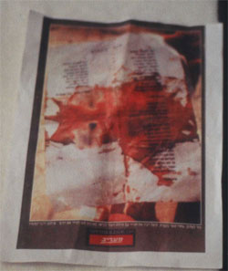

Slide 25
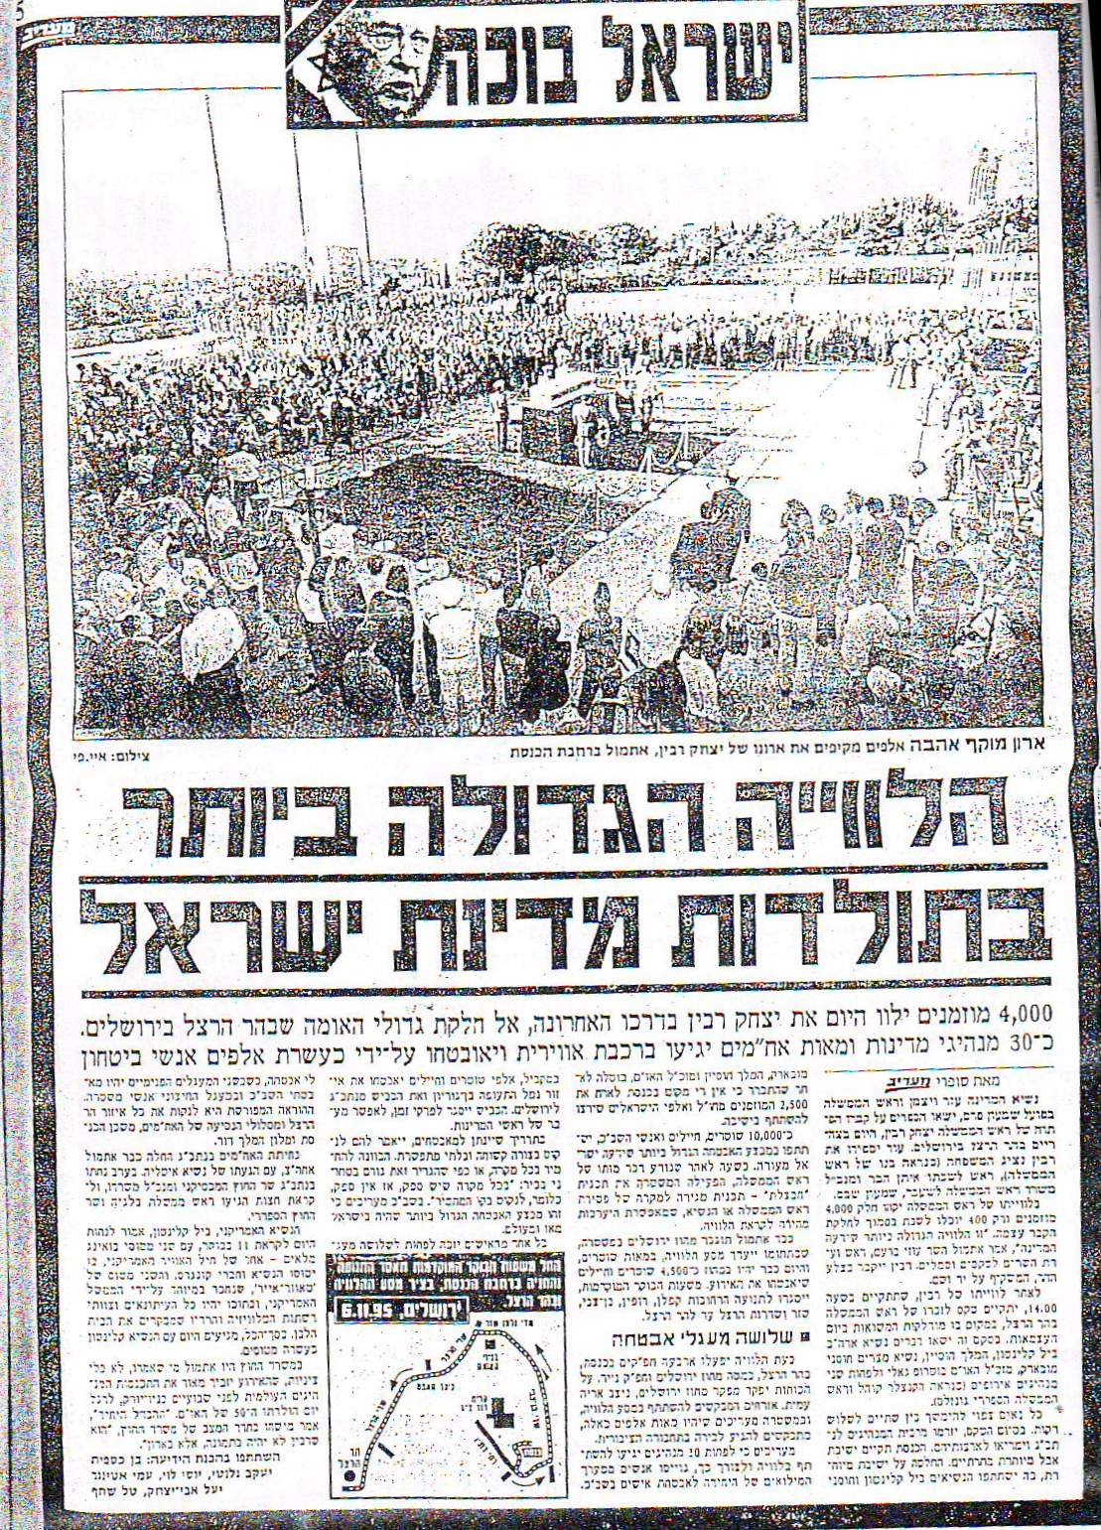
Israel is crying

Slide 26
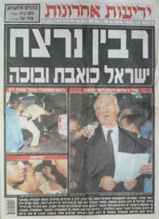
Rabin murdered.

Slide 27
סרט הלוויה

Slide 30
On 4 November 1995 (11th of Heshvan on the Hebrew Calendar) Prime Minister Rabin was assassinated by Yigal Amir, a radical right-wing Orthodox Jew who opposed the signing of the Oslo Accords and believed he was saving the country from a dire fate.

Slide 31
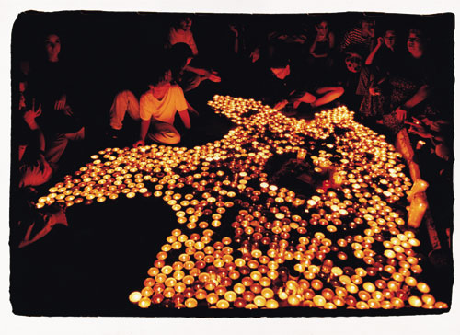

Slide 32
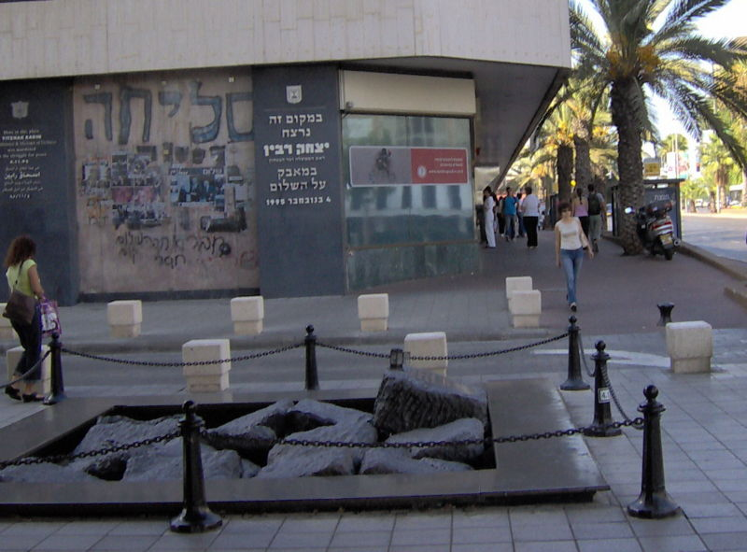

Slide 33
