Slide 1

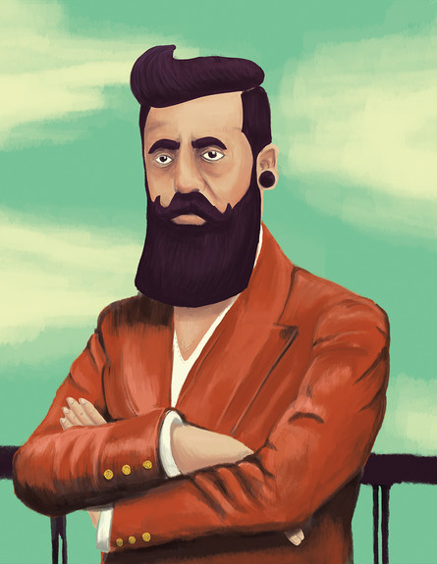
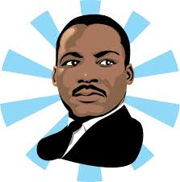
I have a Dream…

Slide 2
I Have a Dream ("Yesh Li Chalom")
I have a dream
And it's much greater than anything else
I have a dream
And it's very ancient and also new
Will come the day, very clear and sweet like honey
I have a dream
Deliver peace
Mountains blue from depth to sea
And sing suddenly
Children will sing from nation to nation
And not in a dream
Their song will touch the heart of the whole world
I have a dream
I have a dream
Which I received as an inheritance from my father
From every abyss
It knew to spread it's wings and ascend
Comes a threat
Arose purity from death and captivity
I have a dream
I have a dream
Fixed like a spring in the heart of the hill
This is the place
From here will shoot forth and rise, and even become stronger
And a song of peace
Will blow from this stone to the whole site
I have a dream

Slide 3
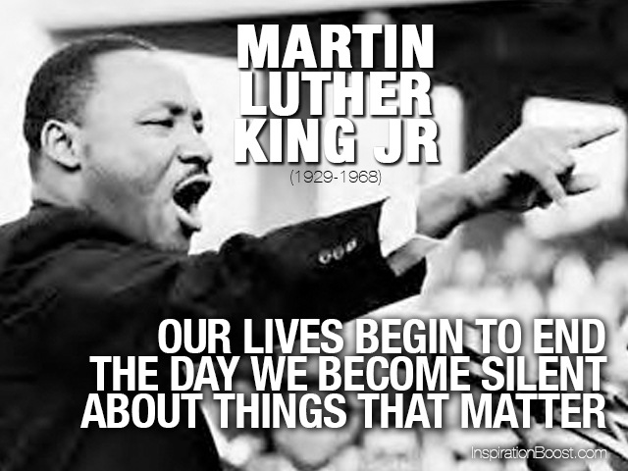
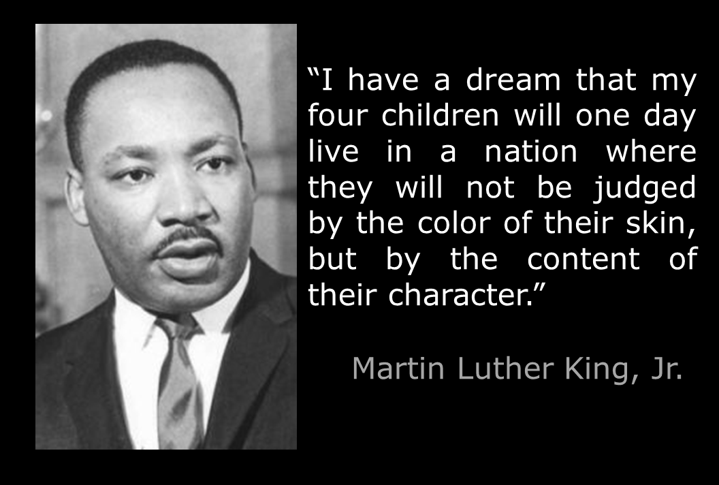
Martin Luther King JR

Slide 4
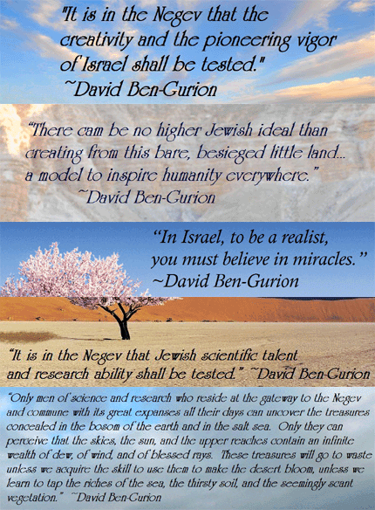
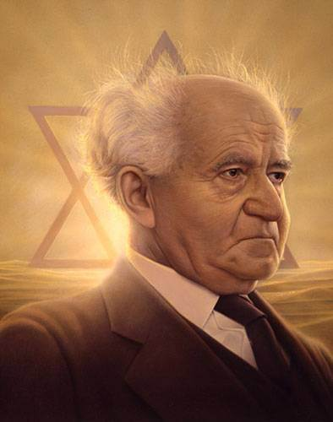
David Ben- Gurion

Slide 5
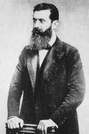
Herzl and the Zionist Idea
Theodor Herzl ( 1860 – 1904)
Khozeh HaMedinah: "Visionary of the State“.
He is considered to have been the father of modern political Zionism.
“If you will it,
it is no dream”.
“ At Basel I founded the Jewish State”.

Slide 6
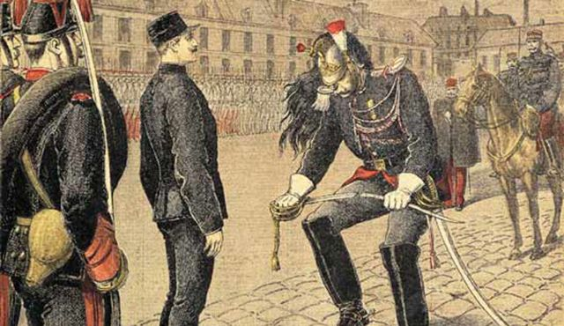


The Dreyfus Affair, a notorious anti-Semitic incident in France.
Herzl was witness to mass rallies in Paris following the Dreyfus trial, where many chanted "Death to the Jews!"
Jewish emancipation and assimilation
to believe that the Jews must create their own state

Slide 7
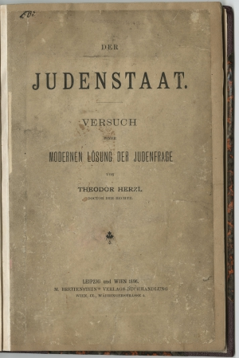
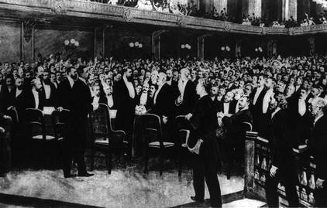
Beginning in late 1895, Herzl wrote Der Judenstaat (The Jewish State).
The book and Herzl's ideas spread rapidly throughout the Jewish world and attracted international attention.
The First Zionist Congress in Basel, Switzerland. He was elected president (a position he held until his death in 1904).

Slide 8
“At Basel I founded the Jewish State. If I said this out loud today l would be greeted by universal laughter. In five years perhaps, and certainly in fifty years, everyone will perceive it”.

Slide 9
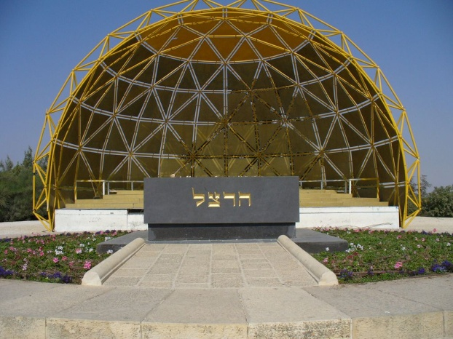
"Greet Palestine for me. I gave my heart's blood for my people”.
Herzl envisioned a Jewish state that combined modern Jewish culture with the best of the European heritage. Thus a "Palace of Peace" would be built in Jerusalem to arbitrate international disputes, and at the same time the Temple would be rebuilt on modern principles.

Slide 10
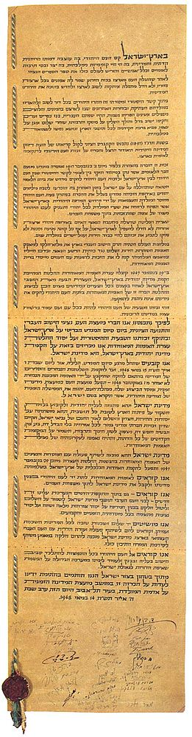
The Declaration of independence
The State of Israel will be open for Jewish immigration and for the Ingathering of the Exiles; it will foster the development of the country for the benefit of all its inhabitants; it will be based on freedom, justice and peace as envisaged by the prophets of Israel; it will ensure complete equality of social and political rights to all its inhabitants irrespective of religion, race or sex; it will guarantee freedom of religion, conscience, language, education and culture; it will safeguard the Holy Places of all religions; and it will be faithful to the principles of the Charter of the United Nations.

Slide 11
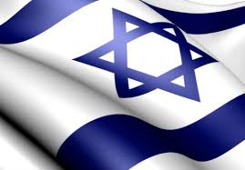
What is your vision for the state of Israel?

