Slide 1
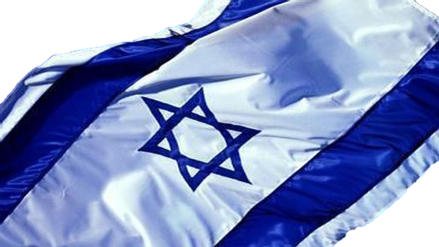
A hike through Zionist history

Slide 2
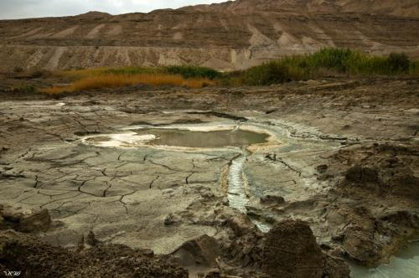
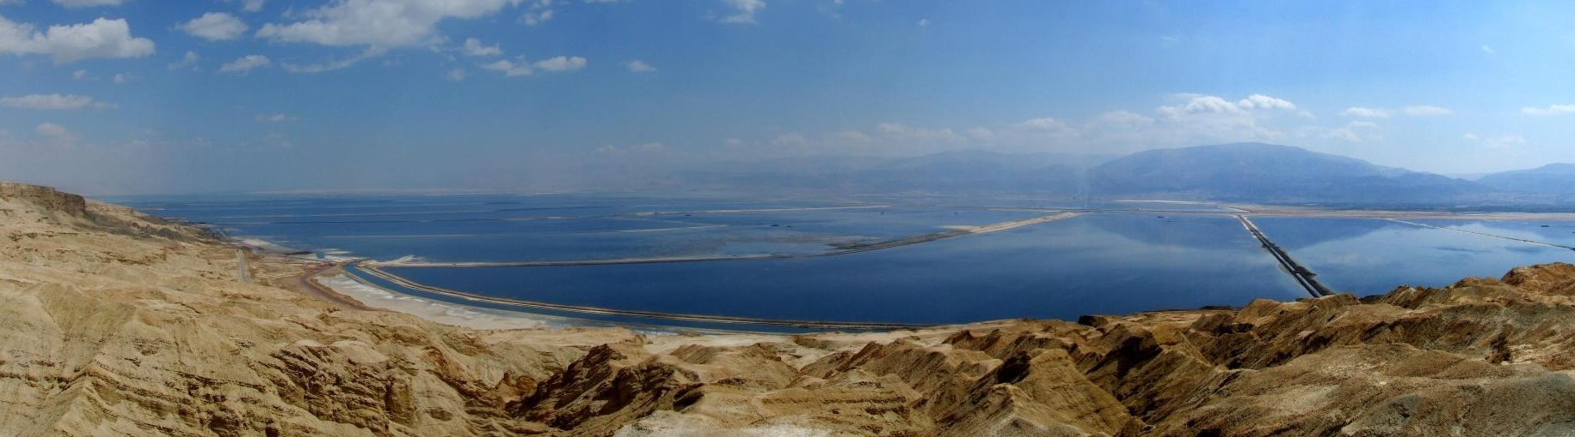
Nothing

Slide 3
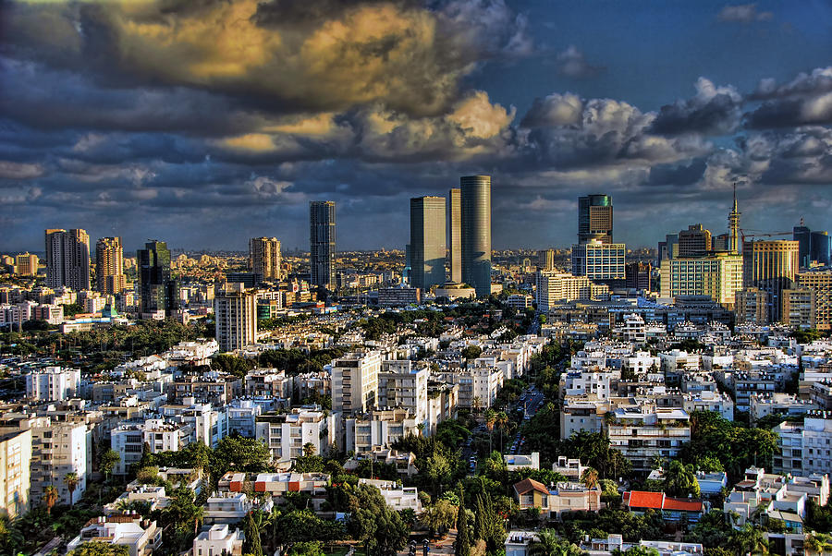
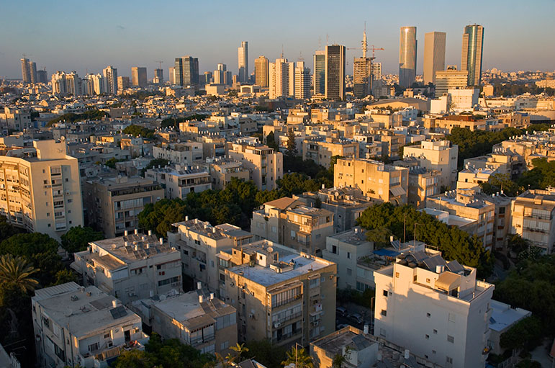
Great Something

Slide 4
What are we talking
about today?
The historic connection of the Jewish people to the land of Israel
The beginning of modern Zionism & The Zionist movement
Balfour Declaration
UN Resolution #181
The declaration of independence of Modern Israel
Zionist achievements

Slide 5
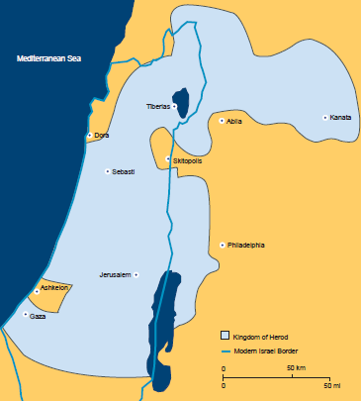
Let’s start with the end
The Roman empire had taken over the land (and annihilated Hasmonean’s dynasty).
Simon Bar-Kokhba tried to lead a Jewish revolt, but the romans crushed it.
After the rebellion had failed, the Roman empire decided to disperse the Jewish people all over the world.
Only few Jews stayed in the area.

Slide 6
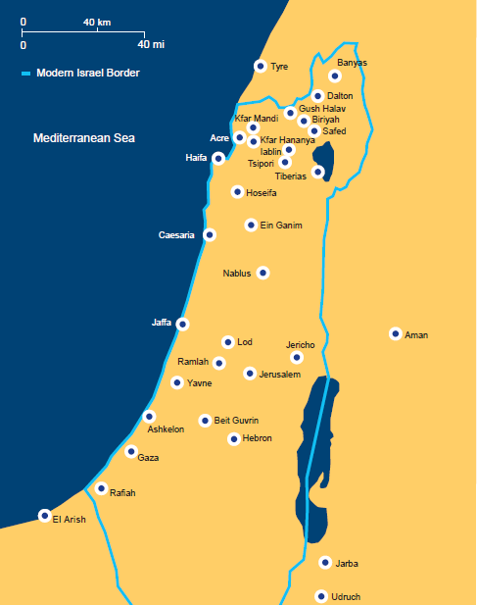
The Jews’ comeback
In 1099, the land was under Crusaders’ rule for 200 years.
The religious enthusiasm towards the land of Israel, encouraged Jews to come back to their ancestors’ land.
Massive groups from England, France and north Africa migrated and formed small Jewish communities (“The Aliyah of 300 Rabbis”).
But then - The Islamic empire conquered the land!

Slide 7
FFW: Modern times
Despite its positive outcomes, created the fear of losing Judaism for good.
Like many other peoples, the Jews had shared history, tradition and even a language.
Assimilation
Nationalism
And so…
Anti-
Semitism
The Zionist
movement was born!
Led to the realization that Jews will always be persecuted.

Slide 8
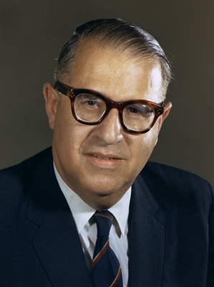
Zionism
"Zionism is nothing more – but also nothing less – than the Jewish people's sense of origin and destination in the land linked eternally with its name".
(Abba Eban, former Foreign Minister of Israel & Ambassador to the U.N.)

Slide 9
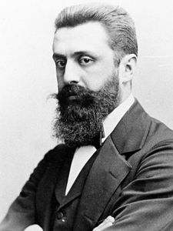
The first Zionist leader
Benjamin Ze’ev Herzl was born in 1860 in Budapest, Hungary, to an assimilated Jewish family.
After a brief legal career in the University of Vienna and Salzburg, he devoted himself to journalism and literature, working as a journalist for a Viennese newspaper and a correspondent for “Neue Freie Presse” in Paris, France.
As a news-reporter, Herzl followed the “Dreyfus Affair” (1894), and witnessed the mass rallies in Paris, where many chanted: “Death to the Jews”.
Herzl came to reject his early ideas regarding Jewish emancipation and assimilation and to believe that the Jews must remove themselves from Europe and create their own state.

Slide 10
The first Aliyah
Between 1882 and 1903, approximately 35,000 Jews immigrated to Palestine, then a province of the Ottoman Empire.
The majority, belonging to small Zionist groups, came from the Russian Empire with a smaller number arriving from Yemen.
Many established agricultural communities. Among the towns that these individuals established are Petah Tikva (already in 1878), Rishon LeZion, Rosh Pina, and Zikhron Ya'aqov.
Settlements of the first Aliya were typically plantations funded by the Baron Rothschild. Approximately half of these immigrants are estimated to have left the land of Israel.
But this was only the “first wave”. By the time Israel would be established, a total of 650,000 Jewish people would have made Aliyah through four more “waves”.

Slide 11
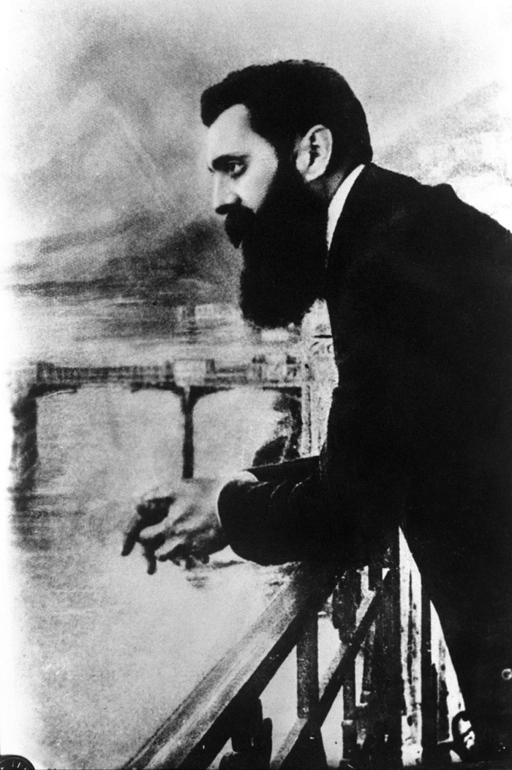
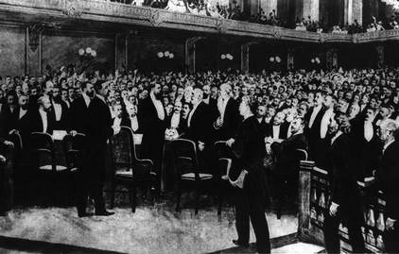
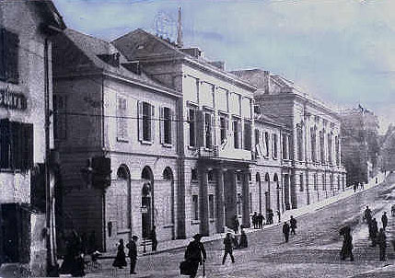
The first Zionist congress
Herzl energetically promoted his ideas, continually attracting supporters, Jewish and non-Jewish alike.
In 1897 decided to convey the “First Zionist Congress”, which was the inaugural congress of the World Zionist Organization (WZO) in Basel , Switzerland.
The Congress formulated a Zionist platform, known as the “Basel program”, and founded the Zionist Organization. It also adopted the “Hatikvah” as its anthem.

Slide 12
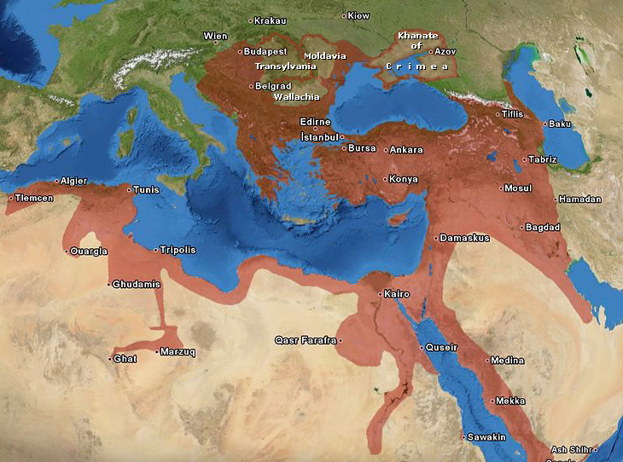
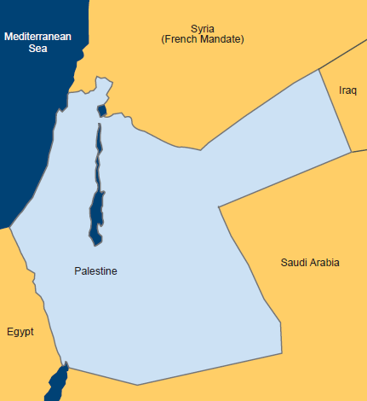
And meanwhile in Palestine…
The Ottoman empire ruled the land of Israel for almost 400 years!
In 1917, During WW2, The British empire conquered the territory from Turks, and four years later established a mandatory rule.
More and more Jews began making “Aliyah” to Israel, to reconstruct the Jewish homeland.
While these people were building the land, the Zionist leaders were trying to persuade the powers for international recognition.

Slide 13
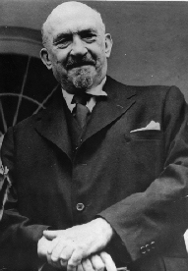
Balfour Declaration
In 1917, Haim Weizmann, scientist, statesperson, and a prominent Zionist, persuaded the British government to issue a statement favoring the establishment of a Jewish national home in Palestine.
The statement, which became known as the “Balfour Declaration”, was in part, payment to the Jews for their support of the British against the Turks during World War I.

Slide 14
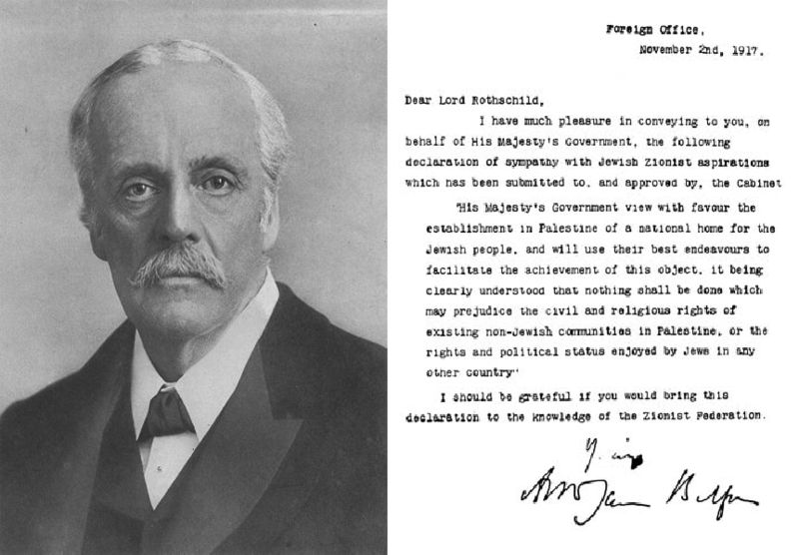
Balfour Declaration
On Nov. 2nd 1917, the Foreign secretary of UK sent a letter to Baron Rothschild, who passed it to the Zionist Federation of Great Britain:
“His Majesty's government view with favor the establishment in Palestine of a national home for the Jewish people, and will use their best endeavors to facilitate the achievement of this object, it being clearly understood that nothing shall be done which may prejudice the civil and religious rights of existing non-Jewish communities in Palestine, or the rights and political status enjoyed by Jews in any other country.”

Slide 15
Beginning of a conflict
The tension between the new Jewish immigrants and the Arab population started to increase.
Spontaneous and sporadic Arab attacks took place against the Jews in Palestine (1921-1929; 1936-1939). Hundreds from both sides lost their lives, and many more were injured.
As a response - The British got “cold feet”. In order to reduce the friction, they limited the number of “Olim” each year and eventually prevented further Aliyah.
The Jewish people resisted the restrictions and rebelled against the British representatives.
Different UN committees tried to solve the crisis – but their efforts were in vain.

Slide 16
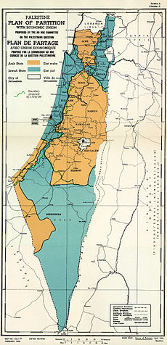
UN Resolution #181
On Nov. 29th 1947, UN General Assembly approved on adopting and implementing the “Partition plan”, AKA “Resolution 181”.
The plan dictated 55% percent for a Jewish state and 45% for an Arab state. Jerusalem and Bethlehem were defined as “Corpus Separatum”.
Most Jews around the world reacted with great satisfaction to the result, where as ALL Arab people and nation opposed to any kind of agreement.
The plan was never fully implemented. After British mandate has ended, A Jewish state was establish and the Israeli-Arab 1948 war has started.

Slide 17
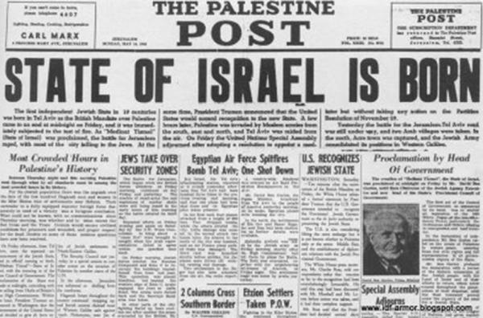
33 states voted in favor of the resolution; 13 against; And 10 states abstained.

Slide 18
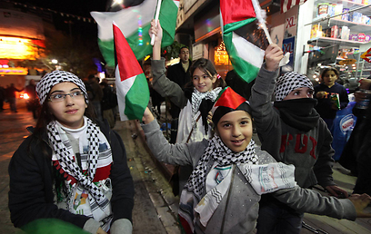
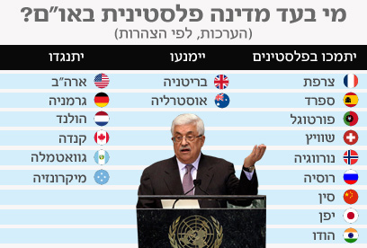
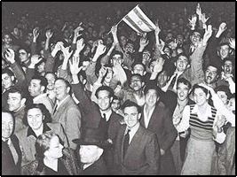
Exactly 65 years after the UN approved the partition plan, the general assembly recognized Palestine as a non-member observer state.
Where the conflict is headed?
Two States solution?

Slide 19
Zionist
Achievements
Aliyah & Society
Culture
Technology

Slide 20
Demography
Israel’s population is an estimated 8.05 million citizens.
75% of whom are Jews.
20% are Arab citizens of Israel.
5% - Other minorities
Israel was established as a homeland for the Jewish people and is often referred to as a Jewish state.
The country's Law of Return grants all Jews and those of Jewish lineage the right to Israeli citizenship.
650K 6 Million
Jewish citizens (1948) Jewish citizens (2013)
65 years

Slide 21
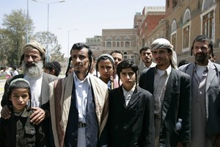
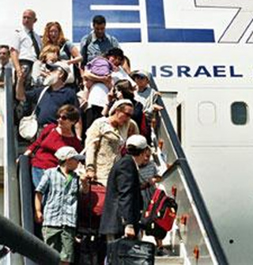
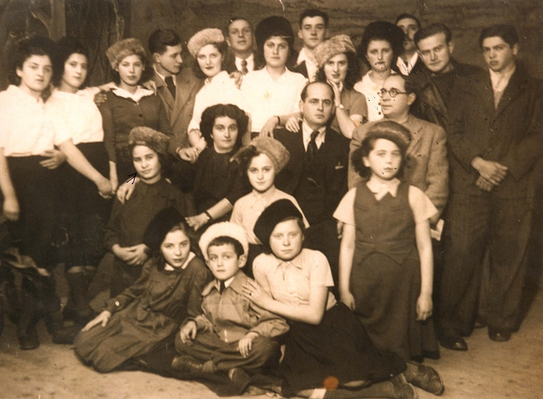
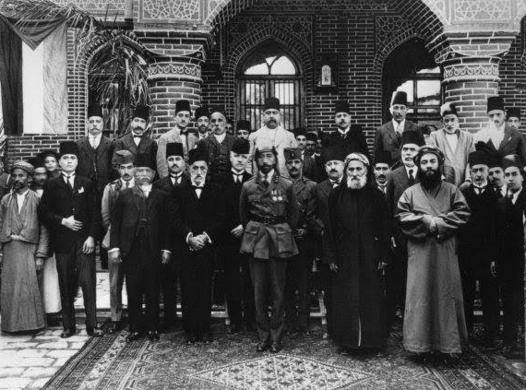

Slide 22
Culture
Israel's diverse culture stems from the diversity of the population: Jews from diaspora communities around the world have created a melting pot of Jewish customs and beliefs.
Israel is the only country in the world where life revolves around the Hebrew calendar.
Jewish holidays
Sabbath.
The Arab minority has also left its imprint on Israeli culture in such spheres as architecture, music and cuisine.

Slide 23
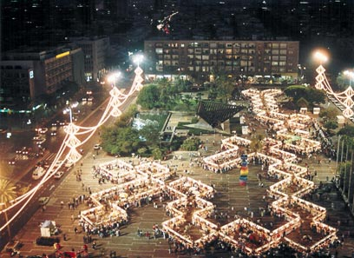
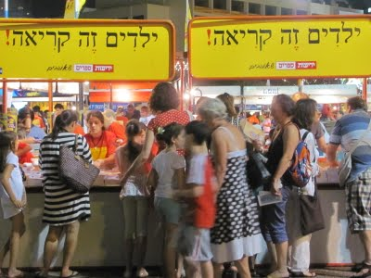

Slide 24
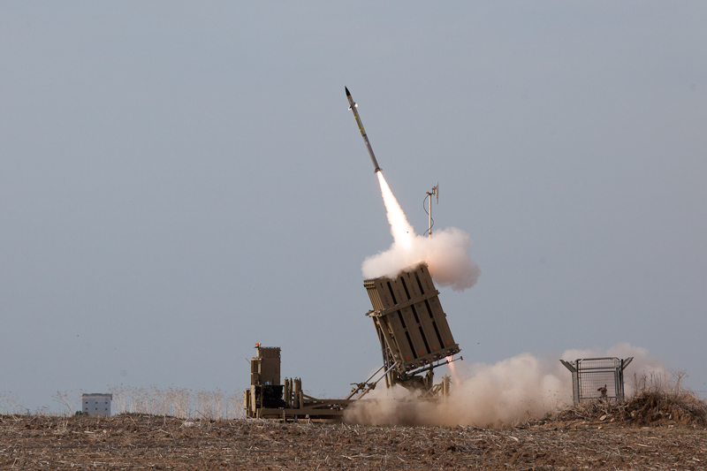
StartUp Nation

Slide 25
Israel: The Vision and Venture
of the Jewish People

Slide 26
Q & A
Thank you for listening!

