Slide 2
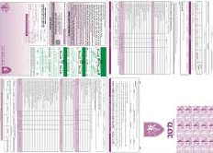
'Tzav Rishon’ From that moment on you are a candidate of the Israel Defense Force, or as they say - “Malshab”
Personal Information
Personal Interview
Medical exams
Tech-sychology exams

Slide 3
Yom Hame’a a day of selection, evaluation and Matching; gives you another chance to prove your personal skills and abilities
Technical
Command and Guidance
Human Relations
Data processing
Management and organizing
Teamwork

Slide 4
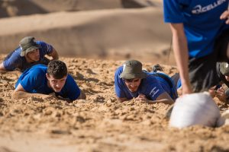
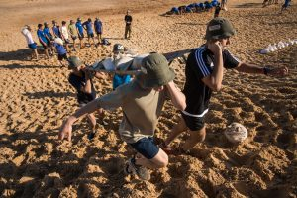
Yom Sayarot Patrol Day is designed to test your suitability for various combat roles as outlined in the Patrol Model. Therefore, it is mandatory to sleep at least 7 hours before the screening day and not to perform intense physical activity in the week before.

Slide 5
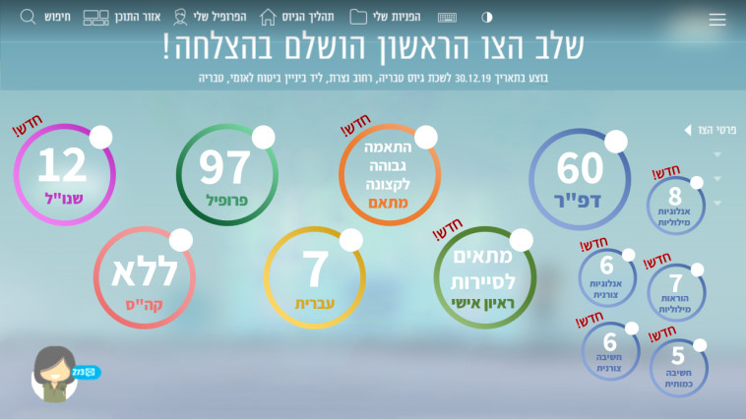
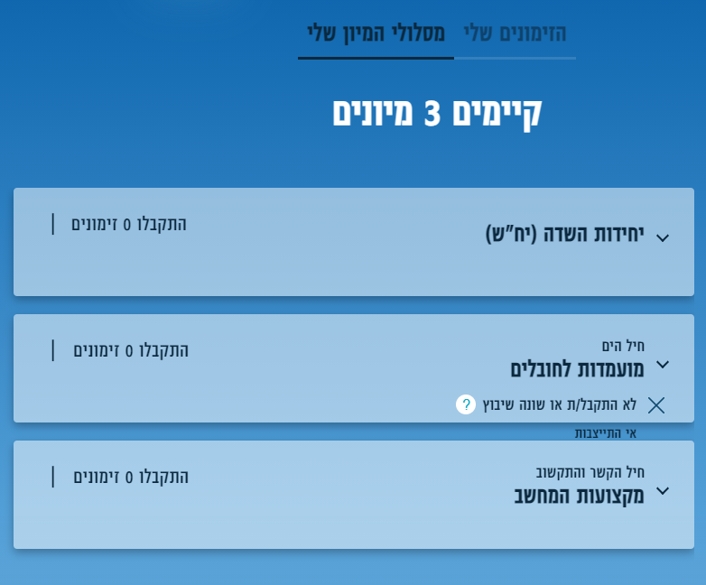
Sorting & Selection process Getting different sumens to come to selective weeks\days. Some are mandatory(showing up).

Slide 6
Manila ranking the jobs you are offered

Slide 7
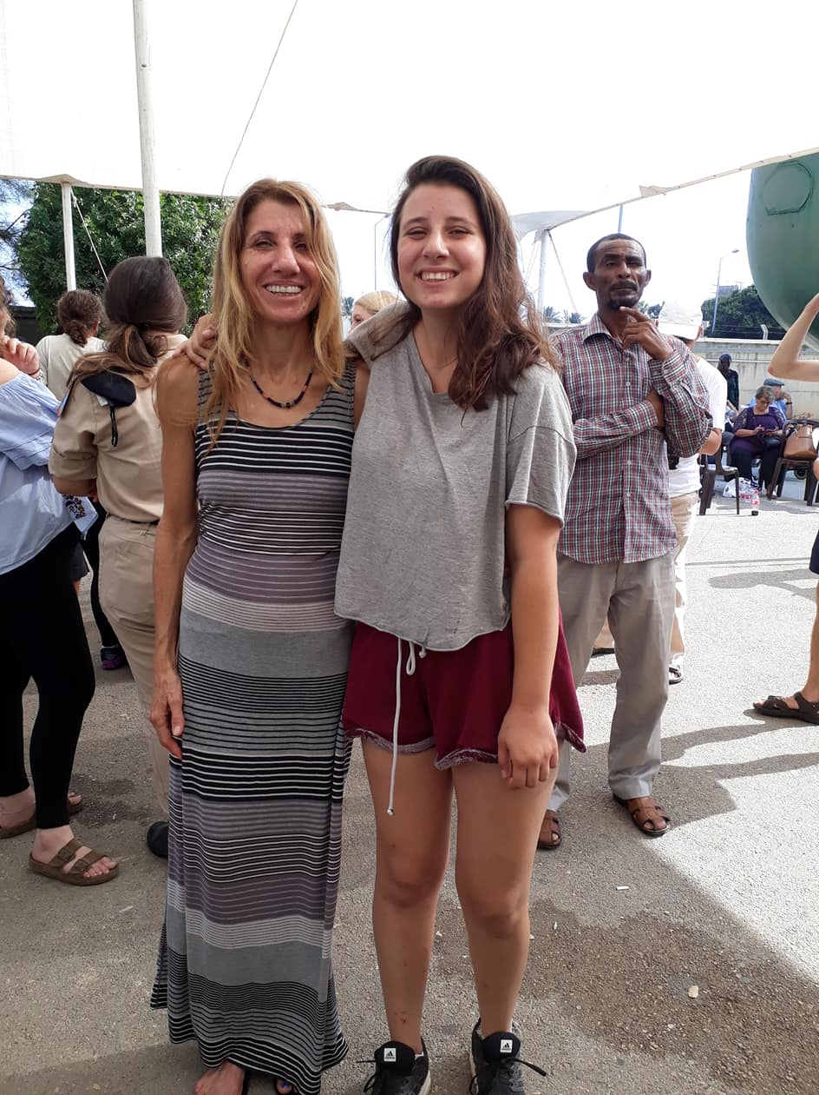
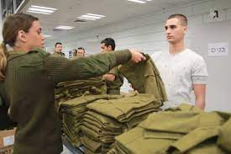
Drafting Day!! Where ___________ what happens there?_______________________ where do you go after?__________________

Slide 8
Quizz – which IDF job will you have?

Slide 9
Medical Profile

Slide 10
Profile 97 Perfectly healthy - fit to serve in various field combat units and in the combat battalions ,as well as in the elite units. Profile 82 Healthy with a slight medical impairment - fit to serve in the various field units and infantry according to the impairment type. Profile 72 Moderate medical impairment (for example mild asthma, knee and back problems, etc.) - qualified for combat service in all combat units except infantry units and elite units. Profile 64 Eligible for service in combat support units& various combat roles such as a Border Police Combatant - 'Magav' ,an Air Defense Command Fighter… Profile 25 A profile given to volunteers with medical or mental health problems Profile 24 temporarily unfit for military service - for example, after a surgery Profile 21 Totally unfit for service for medical health reasons (physical or mental). There is an option to apply for volunteering

Slide 11
DAPAR- KIND OF LIKE THE SAT
Psychotechnics tests, which examine your thinking process and problem solving abilities by conducting quantitative, verbal and formal tests. At the end of the psychotechnics tests, conducted at the Recruitment Center, the grade of the 'Dapar' will be determined. The scores range from 10 (the lowest grade) to 90 (the highest grade) - at 10 point intervals.

Slide 12
K.A.B.A-קבוצת איכות- קב"א “Quality Team”
The 'Kaba' is a numeric figure used by the IDF to assist in the initial placement in military positions, which makes it possible to match the qualifications of the IDF candidate - 'Malshab' - with the requirements of the military roles, and according to the needs of the army. The 'Kaba' score ranges from 41 (the lowest grade) to 56 (the highest grade)

Slide 13
AIRFORCE
POLICE
INTELLEGENCE
helicopter
Flight controller
pilot
MAZLAT- tiny airplain
Police ‘soldier’
MAGAV
border fighter
Army police
Army prison department
Army investigator \prosecutor ..
Intelligence collector
Surveillance
Monitor on borders
Field intelligence collect
Decoder
navigator
Combat plain
Iron Dome
NAVY
Navy border
Rocket ship
Captain
Navy border
TAMAR
comando
sailor
Submarines
NAVAL CONTROLL
Snapir- FINN
GENERAL
EDUCATION
ARMY- Field troops
PARATROOPERS
KFIR
GOLANI
GIVATI
NAHAL
Medical (first med, doctor, dentist, fighter medical, mental health)
Logistic (gun keeper, driver, security guard, cook)
HR\DIAGNOSIS
School\boarding school teacher
Army training school commander
Training commander
sport instructor
Special population
Armed battalion
Search & Rescue
Board field troop
Artillery Corps
Instructor
Field observe
IDF raidio
Army news team
animator
IDF website
IDF spokesman
IDF legal system (attorney, investagetor..)
Army Band\ course \theater
IDF youtubers

Slide 14
What do soldiers get on the drafting day?
Men’s kit | Women’s kit
Shaving cream Hygiene products | Hygiene products
Razor | Razor
Deodorant | Deodorant
Body soap | Body soap
Shampoo | Shampoo
Toiletry kit | Toiletry kit
Earphones | Earphones
Toothpaste | Toothpaste
A holder for your ‘Hoger’ | A holder for your ‘Hoger’
Bamba | Bamba
Bisli | Bisli
Chips | Chips
Soup in a Cup | Soup in a Cup
Coffee | Coffee
Cereal | Cereal
Chocolates | Chocolates
Mentos | Mentos

