Slide 1
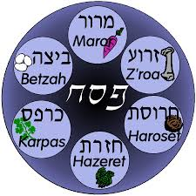
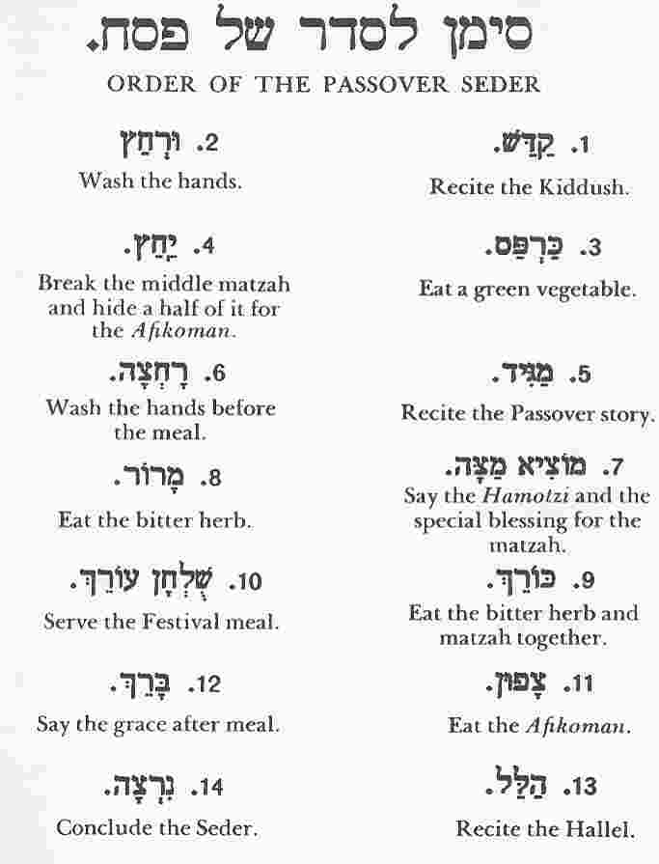
Chocolate Seder
(Z’roa) Tootsi Roll Shankbone
Represents the sacrificial lamb of Passover. The blood of the lamb was placed on the
doorposts of Jewish homes, so that God would "pass over" those homes, sparing the
children of the Jews from the tenth plague – the killing of the first-born son
(Beytzah) - Kinder Surprise
The egg represents the Festival Sacrifice brought to the Temple years ago at this
season. The roundness of the egg also represents the continuous cycle of nature’s
seasons. This may potentially be confused with a chocolate-covered macaroon.
(Maror) - Bitter Chocolate
This bitter chocolate represents the bitterness of our ancestors' enslavement in Egypt.
It helps us to remember that although our ancestors were delivered from Egypt, we
are all still enslaved in our own personal Egypt.
(Karpas) - Strawberry
Like the sumptuous chocolate egg-shaped object, the strawberry symbolizes the
rebirth of the world at this spring season.
(Charoset) - Chocolate Mixture
This is a representation of the mortar that our ancestors used as slaves in Egypt.

Slide 2
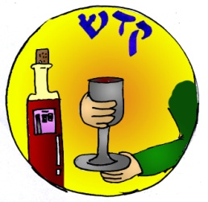
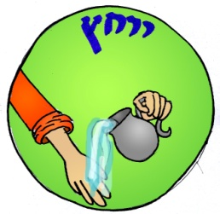
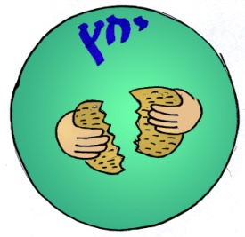
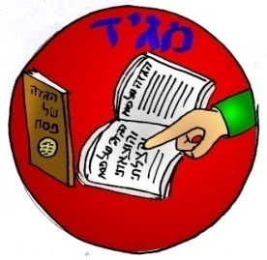
Kadesh: FIRST CUP out of the four cups in the whole seder
Leaning to the left side, drink the First Cup of Chocolate Milk.
Urchatz: We wash our hands and bless
Barukh atah Adonai, Eloheinu, melekh ha-olam asher kidishanu b'mitz'votav v'tzivanu al n'tilat yadayim.
Karpas: Dip the strawberries in fondue
Yachatz: Breaking of the Matzah
Magid: Four Questions (Ma’Nishtana) where we tell the story of passover

Slide 3
Four Questions touch upon the paradox of Seder night, when the symbols of servitude
and suffering intertwine with those of redemption
The four questions reflect the curious paradox of servitude and redemption.
1) On all other nights we eat either peanut butter, chocolate, or a combination of both;
a little peanut butter, a little chocolate, a lot of peanut butter, a lot of chocolate. On this night, why only chocolate?
Ma Nishtana Ha’layla Haze Mikol Ha’laylot? Mikol Ha’leilot?
Shebechol ha’laylot anu ochlin Chametz u’matzah;
Ha’layla Hazeh , Ha’layla hazeh kulo Matzah.
Sebechol ha’laylot anu ochlin she’ar yerakot? She’ar yerakot?
Ha’layla hazeh, ha’layla hazeh Maror Maror
Sebechol Ha’laylot ein anu matbilin afilu pa’am achat, afilu pa’am achat?
Ha’layla hazeh, ha’layla haze’h shtei fe’amim.
Shebechol Ha’laylot anu ochlin bein yoshvin u’bein mesubin?
Ha’layla hazeh, Ha’layla Hazeh kulanu mesubin.
10 Plagues:
We know that as the Israelites fled Egypt, Pharaoh recanted his decision to let the former
slaves go, and he sent his armies after them. As the Israelites approached the Sea of
Reeds, the Egyptians were in hot pursuit. But God parted the Sea of Reeds so that the
Israelites could cross to safety, and as the Egyptians entered the path, the waters crashed
down upon them, and they drowned.
And so, though we benefited greatly from all the evils that befell the Egyptians with the
plagues and the drowning in the sea, our joy is diminished knowing that they suffered,
too. To remember their suffering, we remove ten drops of chocolate milk from our cup,
one for each of the plagues that fell upon Egypt. Each drop of milk we remove is a hope
and a prayer that people everywhere will cast out the plagues that threaten us all,
beginning with those in our own hearts.

Slide 4
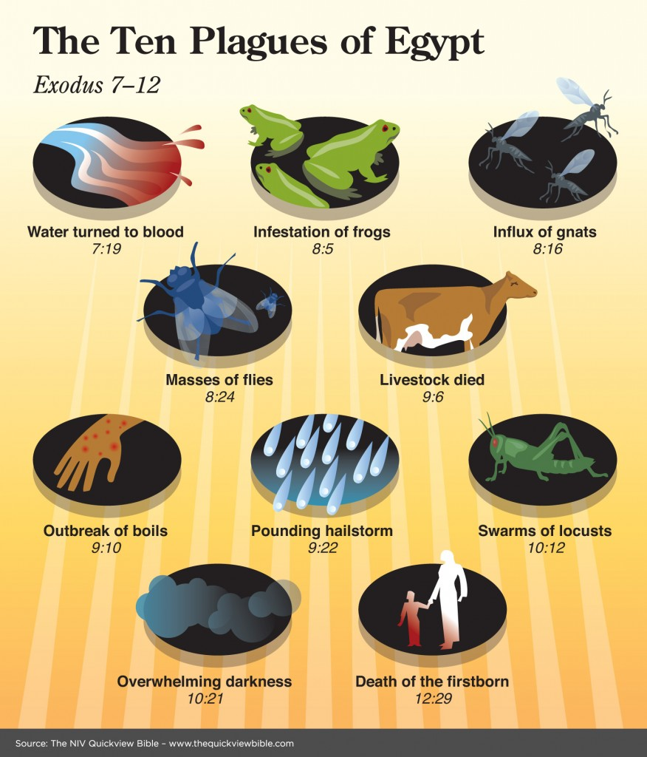
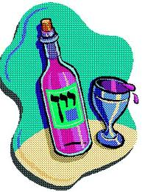
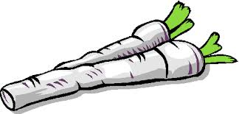
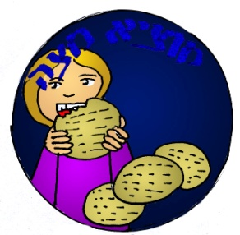
Pesach: Why was the Passover lamb eaten at the time of the Temple? Because God passed over the houses of the Jews when he brought the palgues on the houses of the Egyptians
Matzah: Why do we eat unleavened bread? Because when God took the Jews out of Egypt they left in such a hurry that their dough had no time to rise
Maror: Why do we eat a bitter vegetable? Because the Egyptians made the live of the Jews bitter by forcing them to be slaves
Drink the Second cup of Chocolate Milk.
Motzi Matzah: Break the middle matzah
It’s time to Munch on Matzah! Remember to lean to your left as you eat!
Remember that when the Jews escaped from Egypt they didn’t have enough time for their bread to rise
Rachtzah: Wash hands

Slide 5
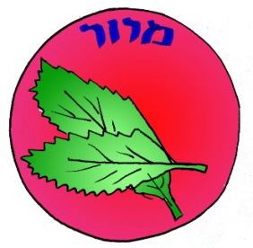
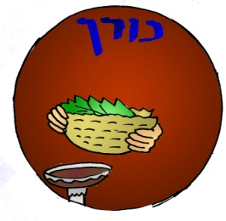
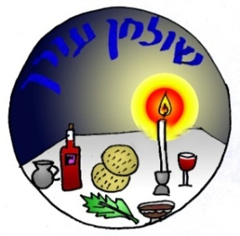
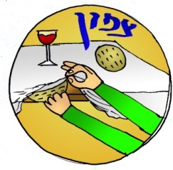
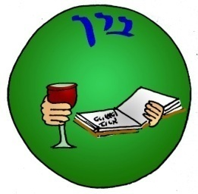
Maror: Bitter chocolate to remember that even though we escaped from slavery in Egypt, we are not completely free and we must always help others who are enslaved to to free.
Korech: Make a matza sandwich
Shulchan Orech: Finally! We get to eat the delicious festive meal! Be-tehavon!
Tzafon: The afikomen is hiding somewhere in the room. It must be found before we can
continue! Celebrate and eat the afikoman when you find it!
Barech: We say grace unto G-d in thanks for our Chocolate Feast.
Blessed art thou, Eternal our G-d, Ruler of the Universe, creator of the cocoa beans of the tree.
Drink the Third Cup of Chocolate Milk.

Slide 6
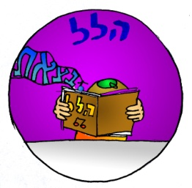
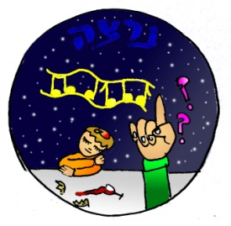
Drink the Third Cup of Chocolate Milk.
Hallel:
Dayenu
Dayenu means
“for that alone we would have been grateful”.
Had G-d brought us out of the land of no-milk and not nourished us on our journey…….Dayenu
Had G-d nourished us on our journey and not done so with chocolate……Dayenu
Had G-d nourished us with chocolate and limited the variety if its forms…………..Dayen
Had G-d enabled us to share in the creation of chocolate and not taught us to mix it with other foods to make it palatable………Dayenu
Had G-d taught us to mix chocolate with other foods and given us milk…….Dayenu
Drink the fourth Cup of chocolate milk
Nirtzah: We end the Passover seder for today, we hope that next year we will be able to celebrate once more.
L’shana ha-ba’ah b’Yerushalayim!
Next year in Jerusalem!
Chag Sameach!

