Slide 1
פעילות ט"ו בשבט לכיתות ד'-ה':
זמן: 40 דק'.
מהלך:
ציור הסביבה שלי- כל ילד צריך לצייר את הסביבה שלו. (+דיון: מה עם הטבע? מה המקום של הטבע בחיים שלנו?)
חלוקה לקבוצות- כל ילד מקבל כרטיס עם שם של חיה. בעזרת פנטומימה וחיקוי החיה בלבד עליו למצוא את כל שאר הילדים שקיבלו את החיה שלו. (כרטיסיות של חיות)
סרטון על ט"ו בשבט/ קטע קריאה בקבוצות/ הסבר עם תמונות. (לא מצורף)
איך חוגגים את החג בישראל? (סדר, נטיעות) (תמונות)
חידון מי אני בקבוצות (החידונים)
הסבר על שבעת המינים (תמונות)
קטע קריאה לסיום. (כמו שלכם יש יומולדת, זהו יום ההולדת לעצים ולטבע)

Slide 2
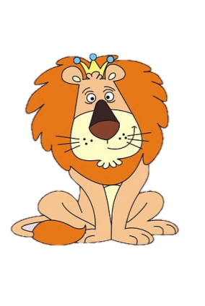
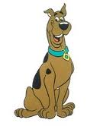
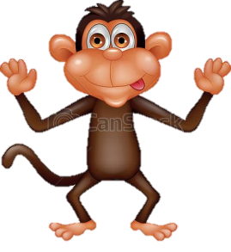
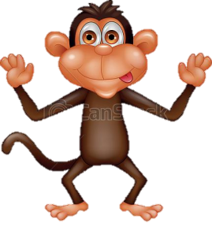
Lion
Lion
Lion
Lion
Lion
Dog
Dog
Dog
Dog
Dog
Monkey
Monkey
Monkey
Monkey
Monkey
Frog
Frog
Frog
Frog
Frog

Slide 3
Cow
Cow
Cow
Cow
Cow
Dog
Cow
Frog
Monkey
Lion
"A man who was going to the desert and was hungry, tired and thirsty- found a tree with sweet fruits, a shadow and a river passes beneath him. The man ate from fruits, drank from the water and sat in the shadow.
When he wanted to leave he said to the tree: “Oh tree, what could I bless you? You already have it all! That tour fruit will be sweet? Your fruits are sweet! That your shade will be great? Your shade is great! That you will always have water? you have plenty of water!
I bless you that all planting that would grow from you will be just like you. "

Slide 4
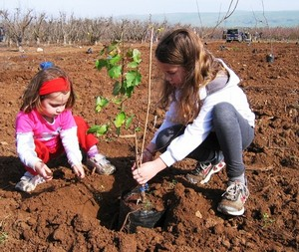
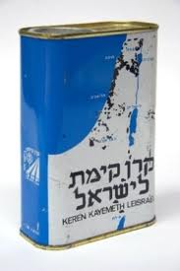
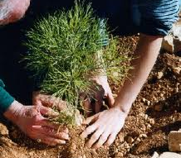

Slide 5
Guess Who, Tu B’shevat Edition
I’m green on the inside and green on the outside too.
Inside my fruit is a present, waiting for you.
Take it and plant it, I’ll become a big tree
Or dine on my fruit, I’m full of vitamin C.
I’m a ____________________________
I’m round you can squeeze me, so put me to use
At your breakfast table, I make a mighty fine juice.
Or if you up for treat that is nice,
Peel off my skin and bite into slice.
I’m a _________________________________
I’m red, green or yellow, sour or sweet.
When eaten with honey, I’m a Rosh Hashana treat!
I’m round like a tennis ball, and you know what they say…
An _______________ a day keeps the doctor away!
I come in pink or I come in red,
I have no stem but a crown instead.
Inside me you’ll find seeds; one hundred or more.
I’m bitter but I’m juicy and good to the core.
I’m a __________________________________
I grow in bunches on the vine.
I’m purple or green and I taste just fine.
My juice is pressed and made into wine.
To drink on Shabbat when we sit down to dine.
I’m a ______________________________
I’m a tiny fruit, but often seen.
I’m the symbol of peace and come in black or green.
Before you bite into me, take out my pit.
In salads or on pizza, I’m always a hit.
I’m a ______________________________
I’m long and I’m yellow, and grow in a bunch.
Pack me in your bag and take me to lunch.
Into the bin give my peel a flip,
But not on the ground people will slip.
I’m a ______________________________
I grow high in the palm tree.
I’m brown and I’m sweet.
If you climb up and pick me,
You’ll have a real treat.
I’m a ______________________________

Slide 6
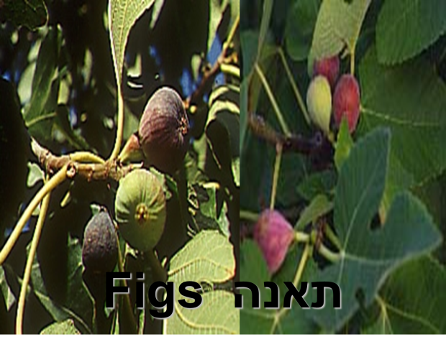
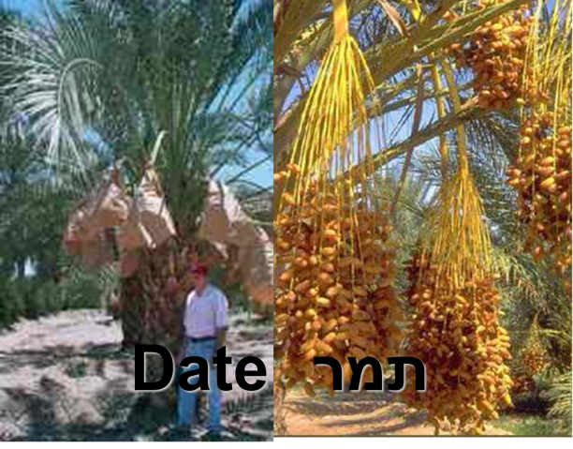
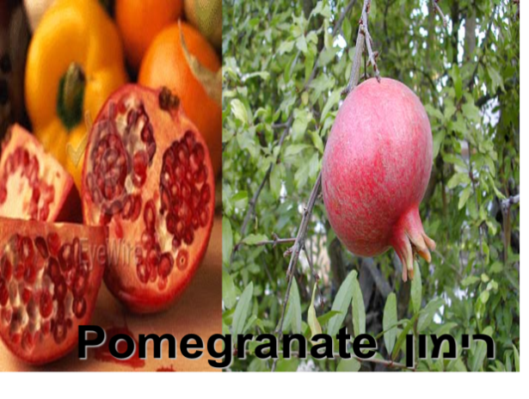
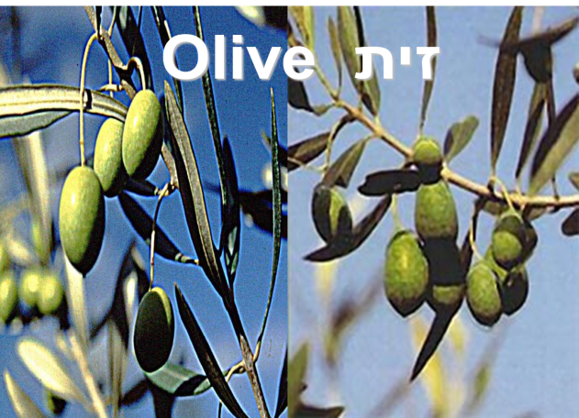
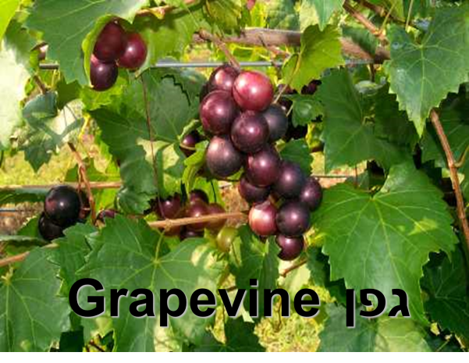
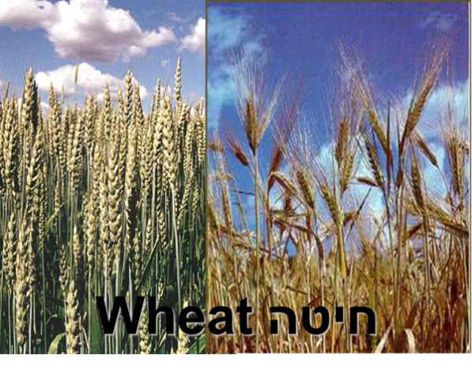
Seven species

Slide 7
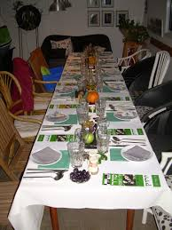
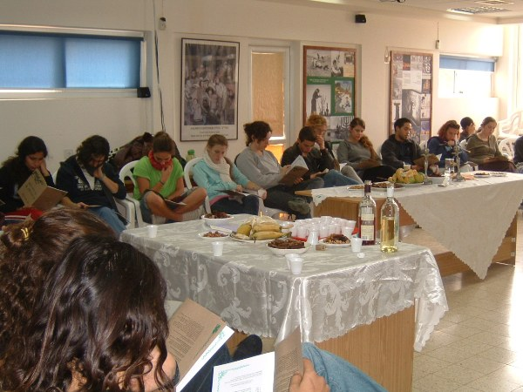
Seder Tu B’shvat!

