Slide 1
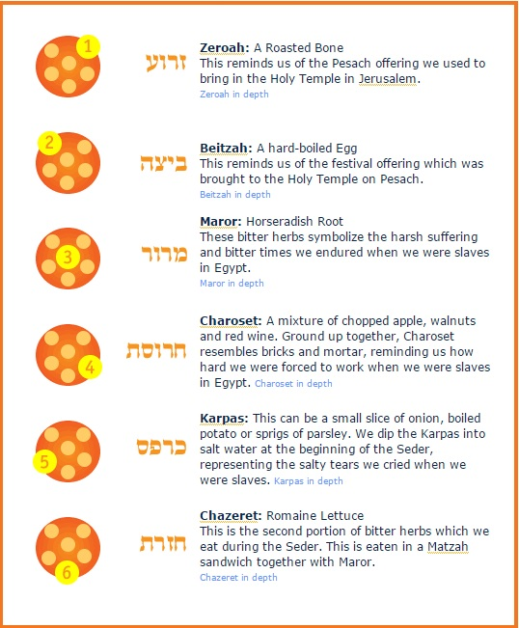
The Seder Plate
The Seder Plate

