Slide 1
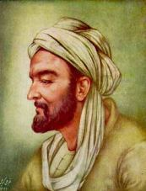
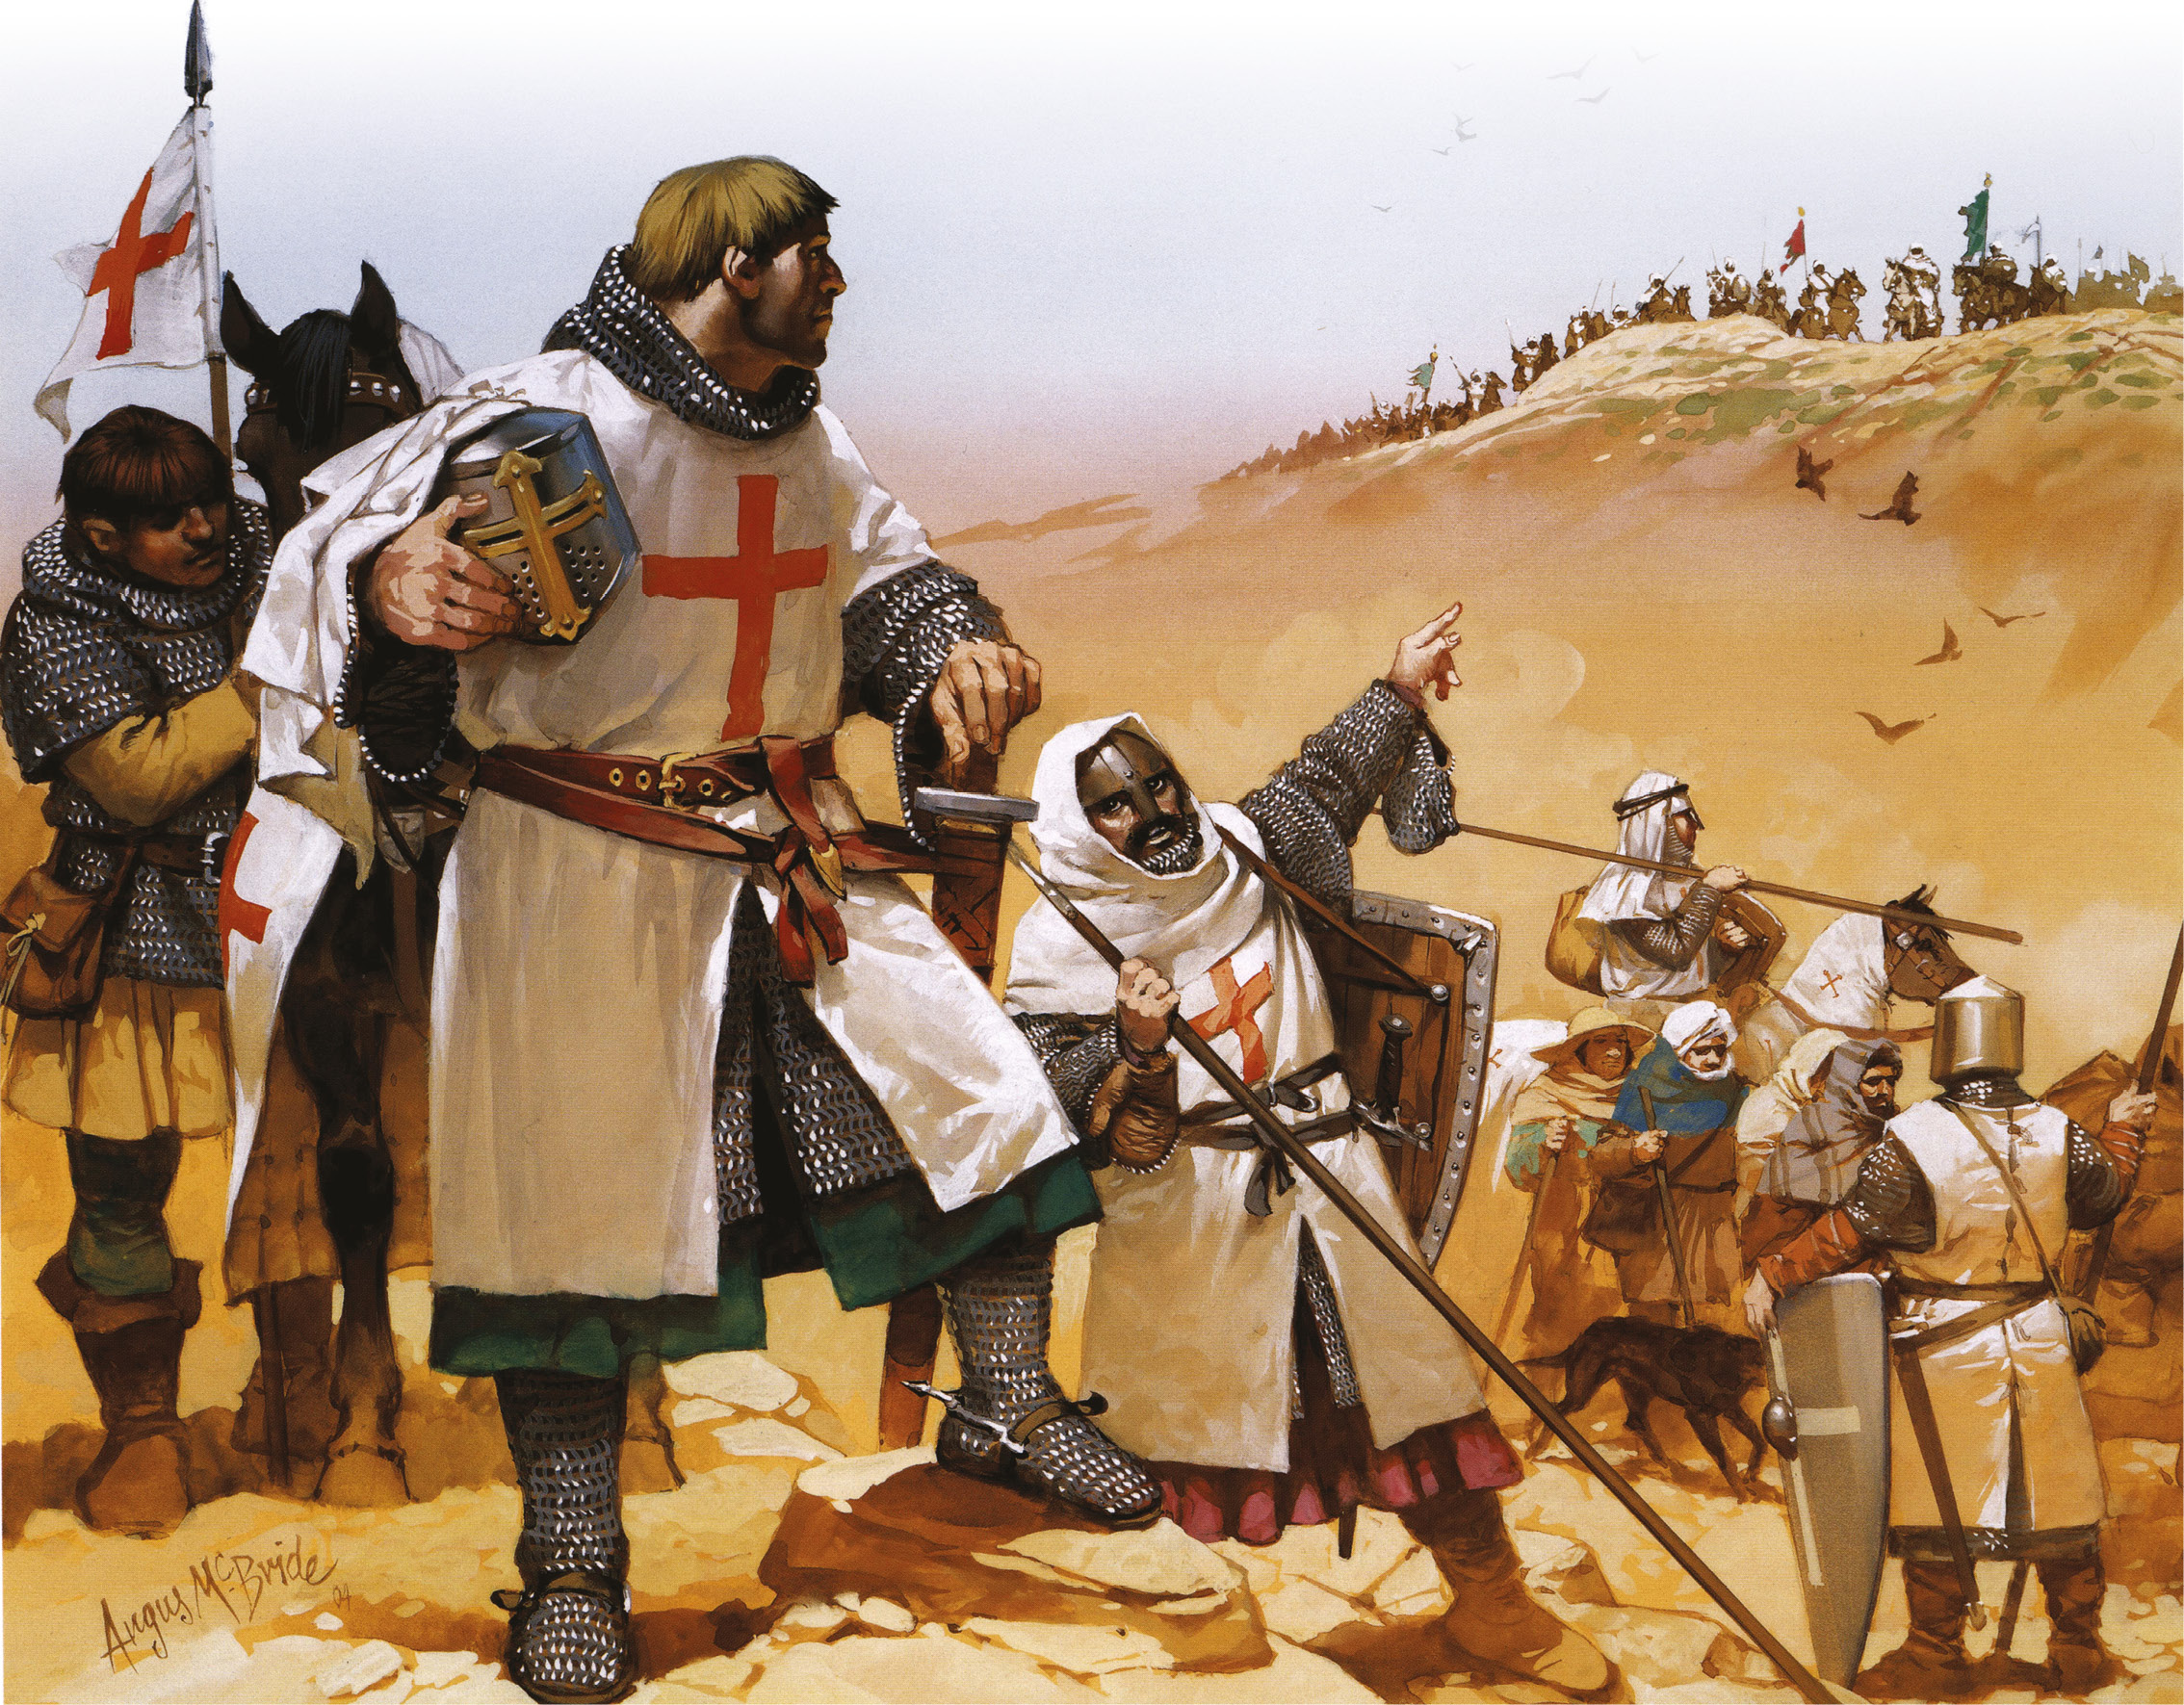
Arabs
Crusader

Slide 2
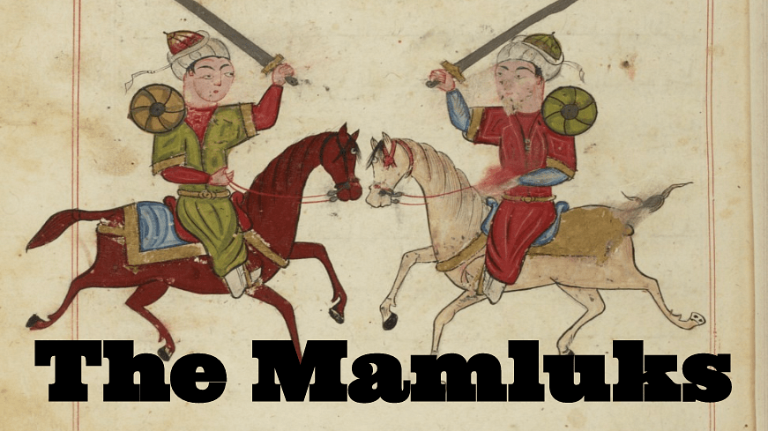

Slide 3
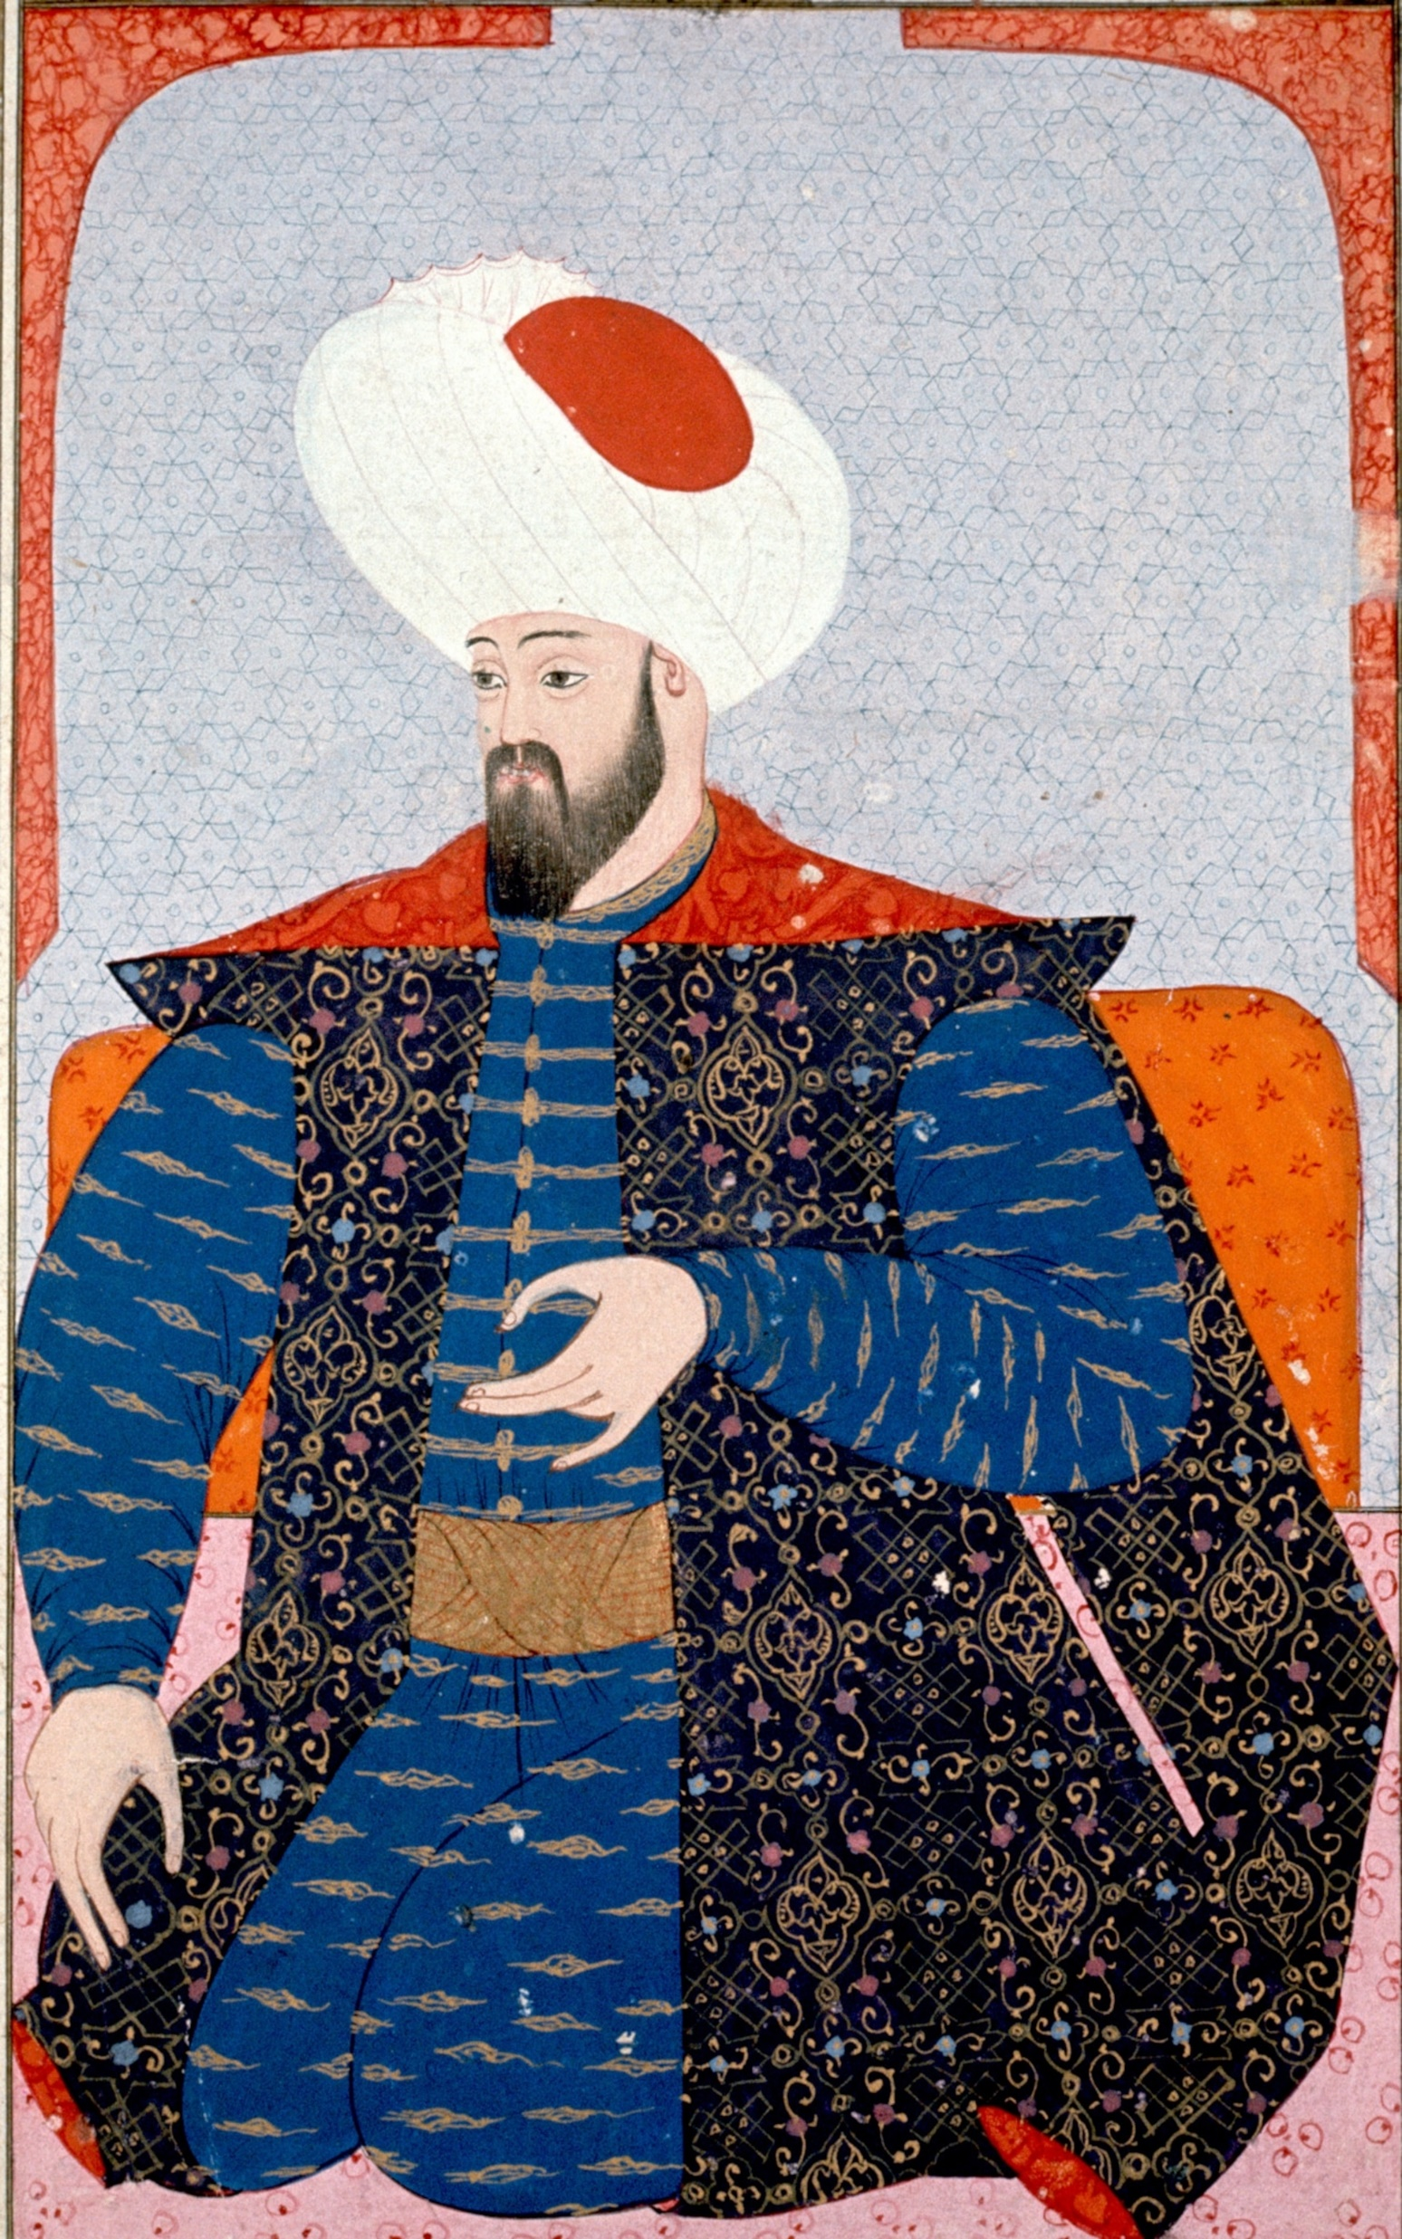
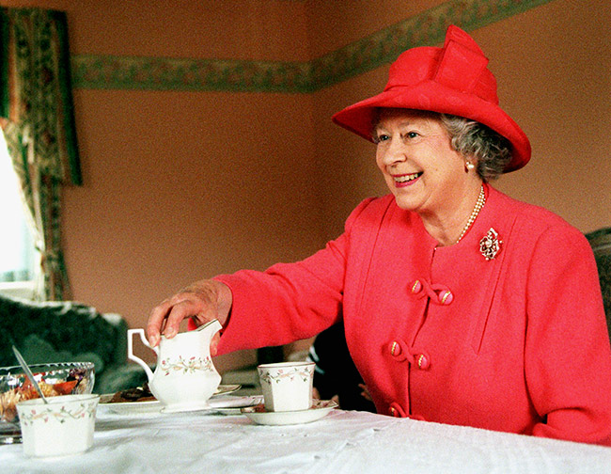
The Ottoman Empire
The British Empire

Slide 4
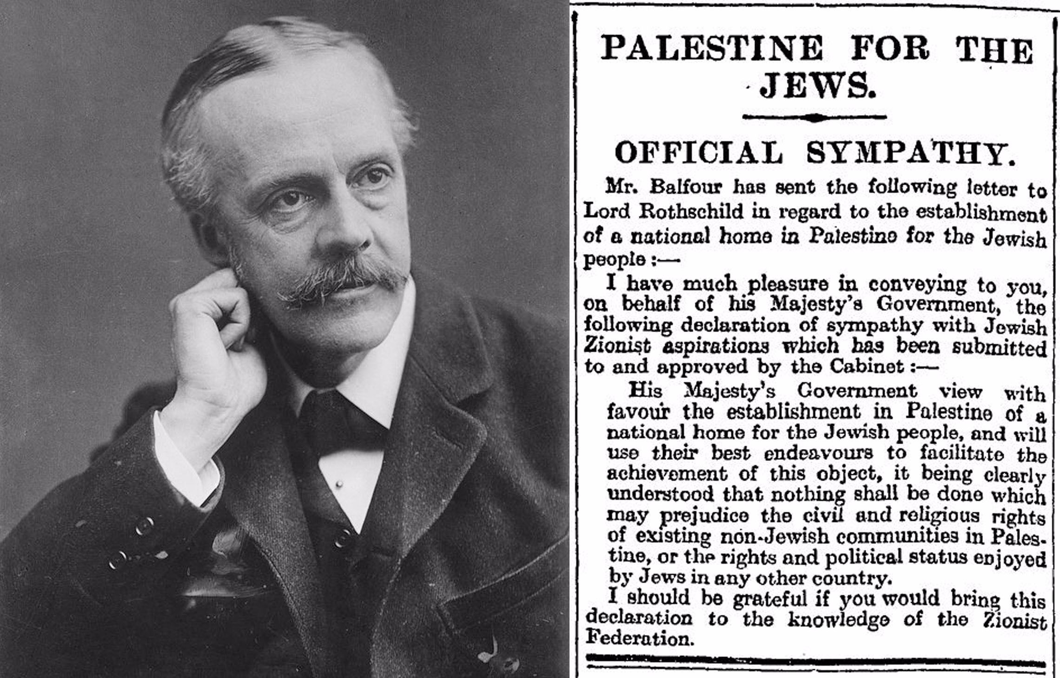

Slide 5

The white book- the name is because it was white.
A book of rules and restrictions for the people on the land of Palestine, between all of them a specific rule that restricts the number of people who can come and live in Israel, to so Aliyah.

Slide 6
Soviet union
Great Britain
The United States

Slide 7
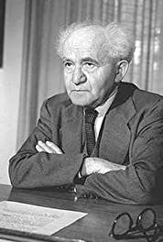
Japan
Italy
Nazi Germany

Slide 8

1947
Independence war
1948
Establishment of Israel
1917
1918

Slide 9
1933-1942
1944

