Slide 1
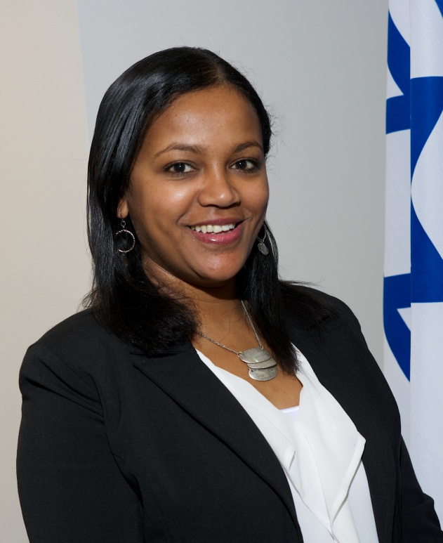
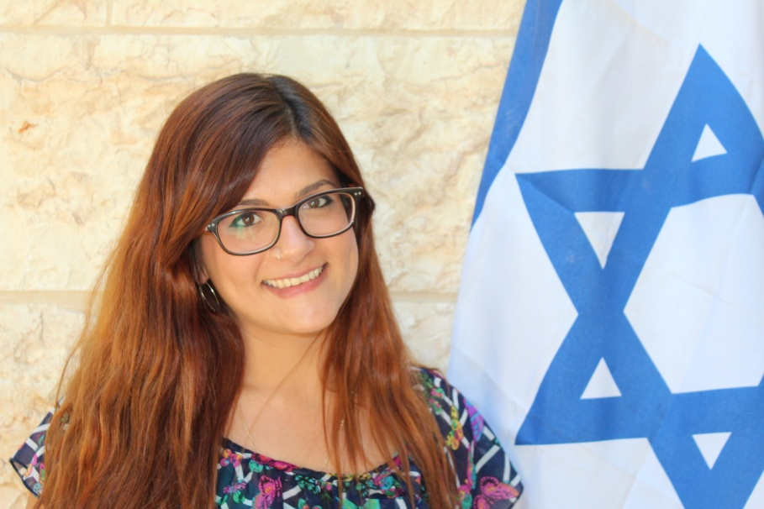
Influential Women In Contemporary Israel

Slide 2
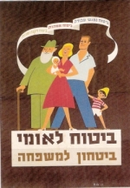

Slide 3
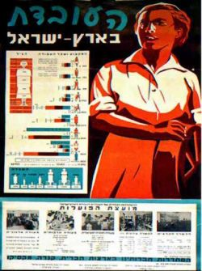
Notes:
ההיסטוריה של נשים בישראל מתחילה במאבק על שוויון. על אף העבודה כי החברה היישובית התארגנה כחברה חדשה שאימצה לעצמה רעיונות דמוקרטיים של שוויון, ועף אף העובדה כי נשים כמוגברים הצטרפו לתנועות החלוציות, לכיבוש העבודה, לבניית התרבות והחברה העברית, לקיבוצים ולמחתרות. השוויון היה יותר סיסמה מאשר מציאות בפועל. בכל אחת מהמסגרות נדחקו הנשים לתפקידים שוליים, ונאלצו להיאבק על זכותן להשתתף כשוות

Slide 4
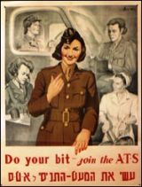
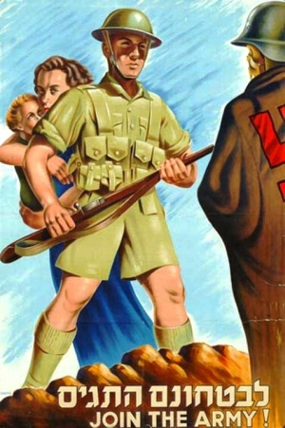
Notes:
when the IDF was created women served primarily in roles such as educators and administrators. Then, during the Yom Kippur War (1973), due to a growing need for ground forces, women were needed in roles in the field. They served as combat instructors, operations sergeants, and even officers.
women also served on the field in charge of combat training equipment, as gunnery instructors for the armored force, as soldiers in the light infantry battalion, as commanders of field intelligence forces and more.

Slide 5
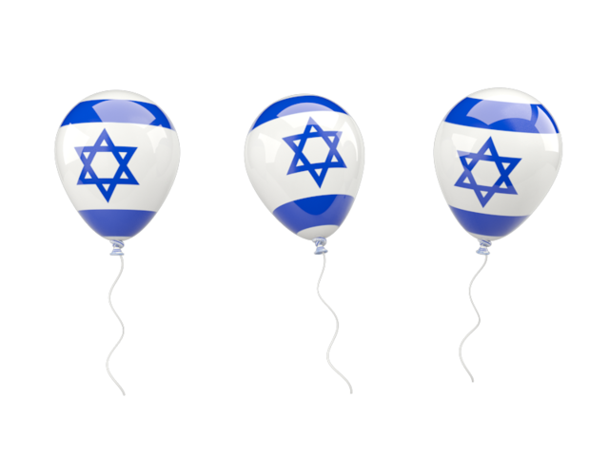
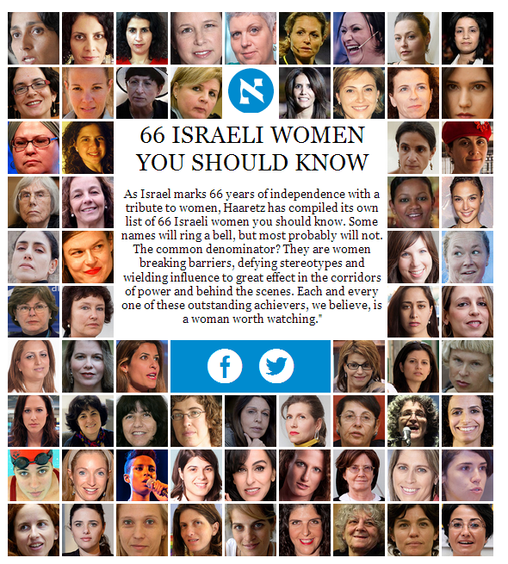
Israel celebrates Women Empowerment 66 Years of Independence

Slide 6
Some Statistics..
At the Last Knesset (Knesset 19) 22.5% of the members were women.
The percentage of women at the governmental directorate has raised to 45.3%.
For the first time in the history of Israel a woman was elected to be the head of a religious council (in Akko).
57% of the students in Israel are women.

Slide 7
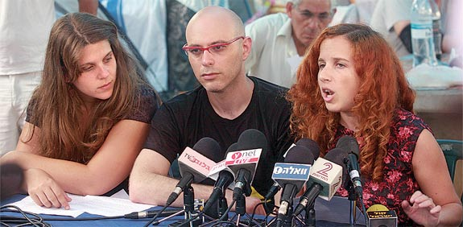
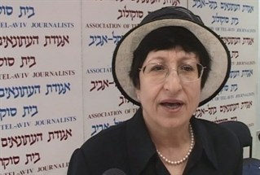
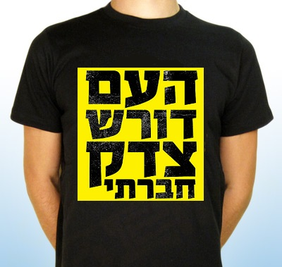
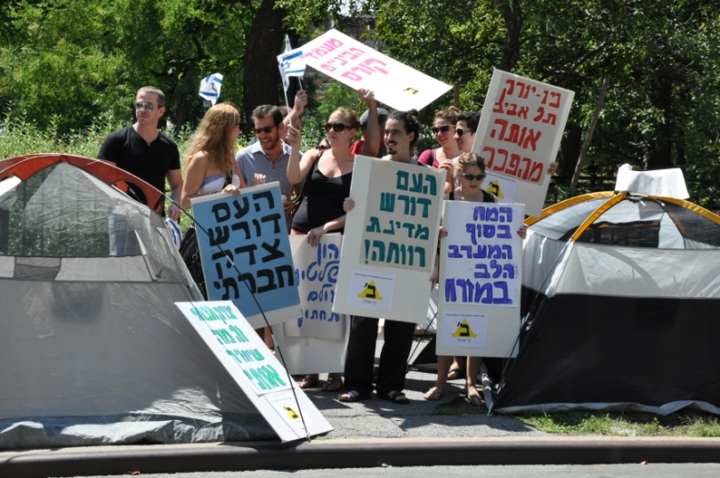
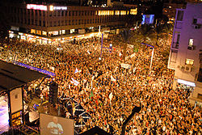
2011 Israeli social justice protests
Notes:
עדינה בר שלום, בקיץ 2011 השתתפה בצוות ספיבק-יונה (ועידה אלטרנטיבית לועידת טרכטנברג) שקם בעקבות המחאה החברתית.
סתו שפיר ודפני ליף, ממקימות המחאה החברתית

Slide 8
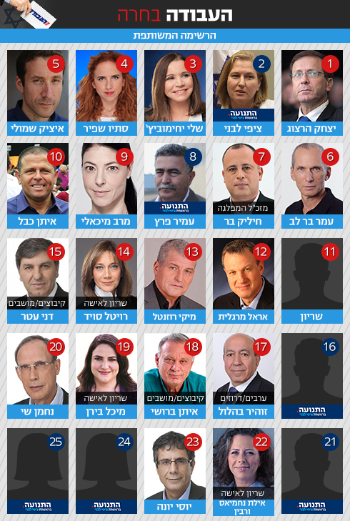
Notes:
ישראל ביתנו עשתה שינוי ברשימה שלהם לאחרונה בכך שהזיזו נשים לחמישה מקומות ראשונים, כמו כן יש עתיד.

Slide 9
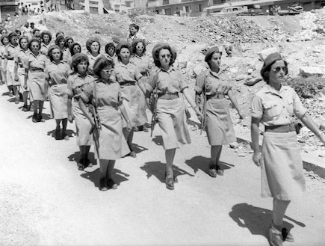
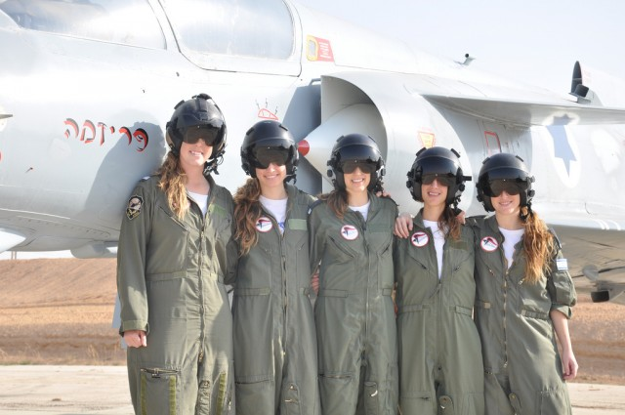
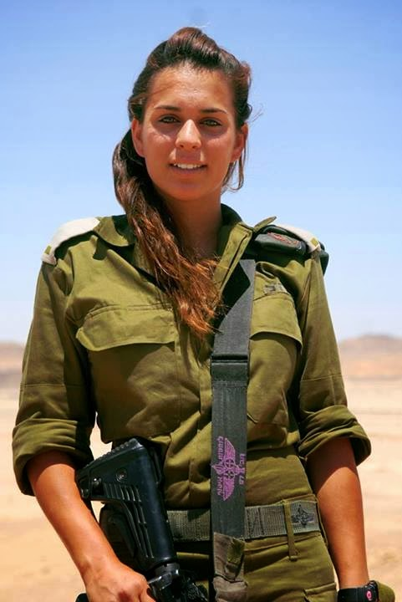
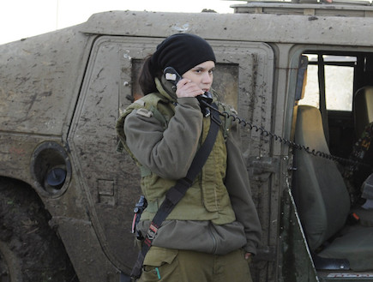
According to the Israeli Defense Forces' official blog, 34% of those serving in the IDF are women, including 23% of all officers and non-commissioned officers. 90% of the IDF’s positions are open to women, including combat roles.
Over the last decade record number of combat positions were open to women including pilots, naval ships captains and infantry soldiers
Women comprise 57% of the IDF's officer corps among regular soldiers, and 28% of career officers. Of the top officer positions (lieutenant and higher) women comprised 15% of the total officers
There has been a significant drop in the numbers of women assigned to secretarial and clerk roles, from 21% of all women serving in 2001 to just 13% in 2012

Slide 10
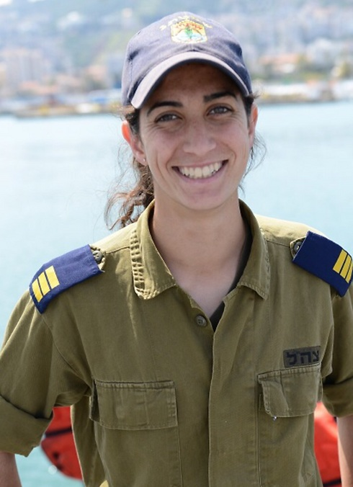
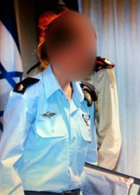
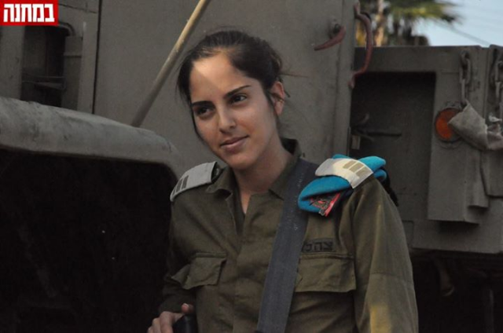
Captain Or Cohen, Commander of an Israeli Navy Vessel
Major Gal, Deputy Squadron Commander
Captain Efrat Kaikov, Artillery Corps Battalion Commander

Slide 11
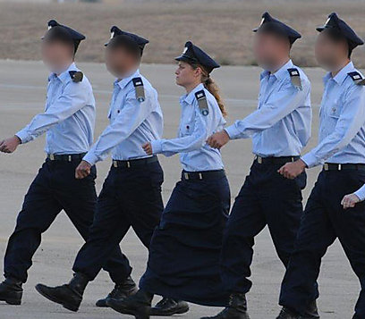
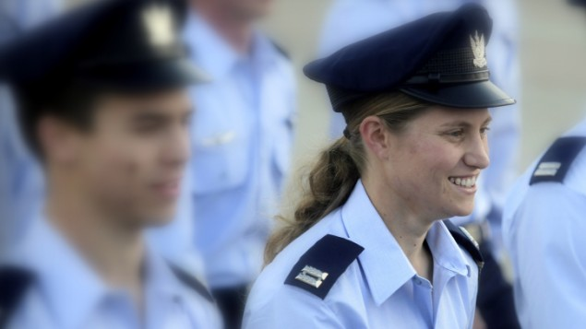
Cpt. Tamar Ariel was Israel’s first female religious air force pilot, a rear-seat, F-16D navigator. Tamar, who was served as the first Orthodox female navigator in the IAF, was killed by an avalanche in the Himalayas last October.
Notes:
She stated that she was Orthodox, received an exemption from army service on the spot, and served for two years as a Bnei Akiva youth leader and a counselor in her former school.
Upon completion, however, Ariel decided that she still had not fulfilled her potential and turned back to the army, rescinding her earlier statement. In April 2009 she passed the week-long physical exam and was accepted to the prestigious course

