Slide 1
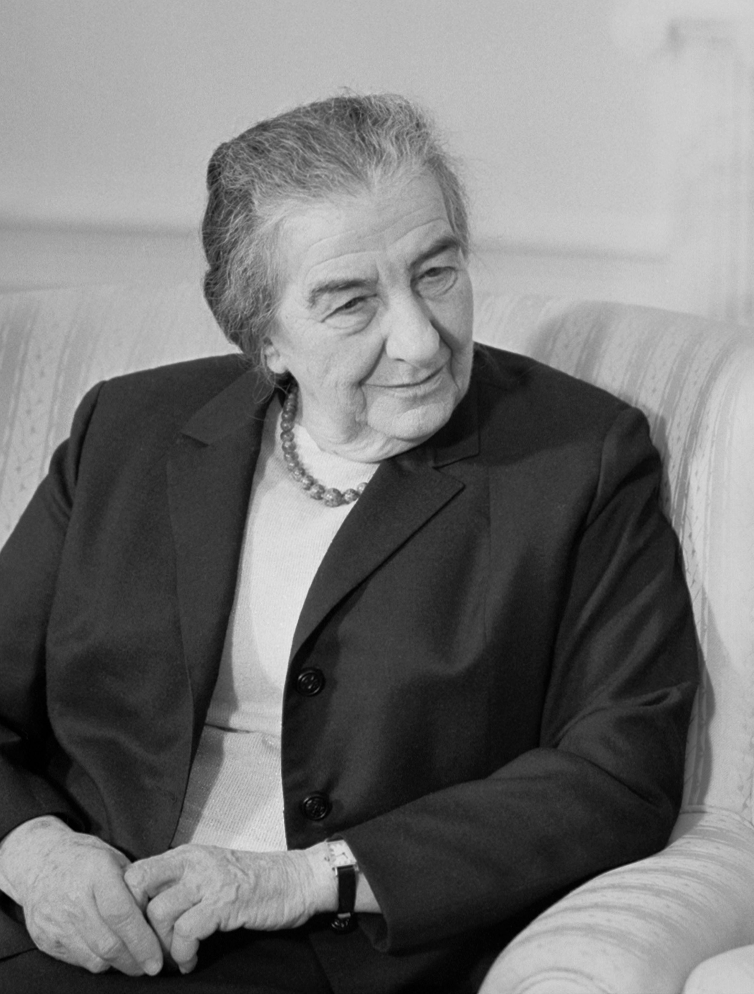

Slide 2
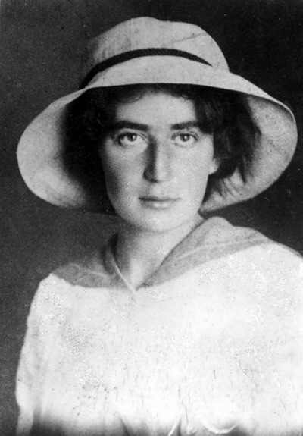

Slide 3
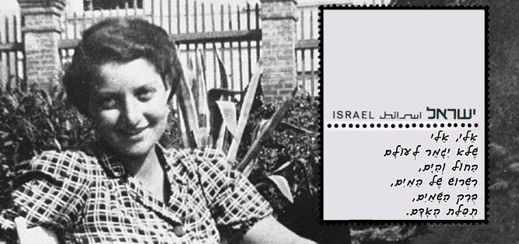

Slide 4
Golda Meir
Hanna Senesh
Rachel

Slide 5
Born in Kiev, Ukraine
Grew up in Milwaukee
Prime Minister

Slide 6
Helped rescue Jews from Europe
Jewish Paratoopet during the World War II
Born in Budapest, Hungary

Slide 7
Worked with Jewish Refugee children
Poet
Born in Russia

