Slide 1
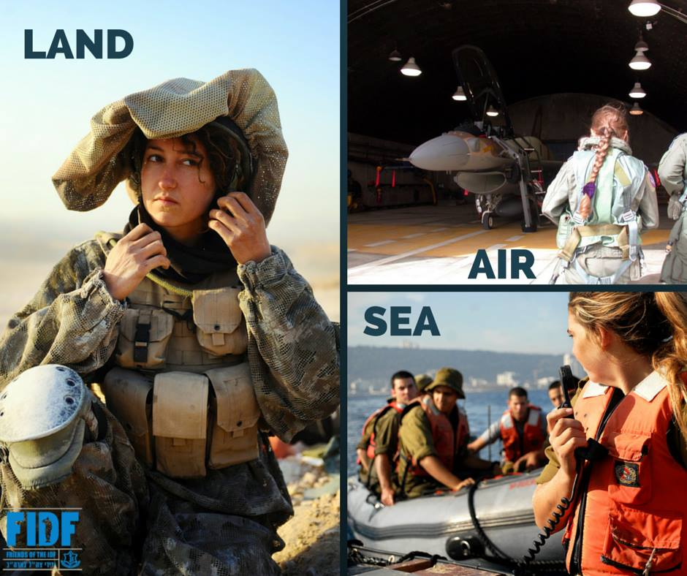
Women In The IDF

Slide 2
Why?
1. Basic law-Human rights: the equality principle -
Core value in Israel as a democratic state.
2. Significant and valuable service of the women will contributed to the goal of the IDF: defending Israel.

Slide 3
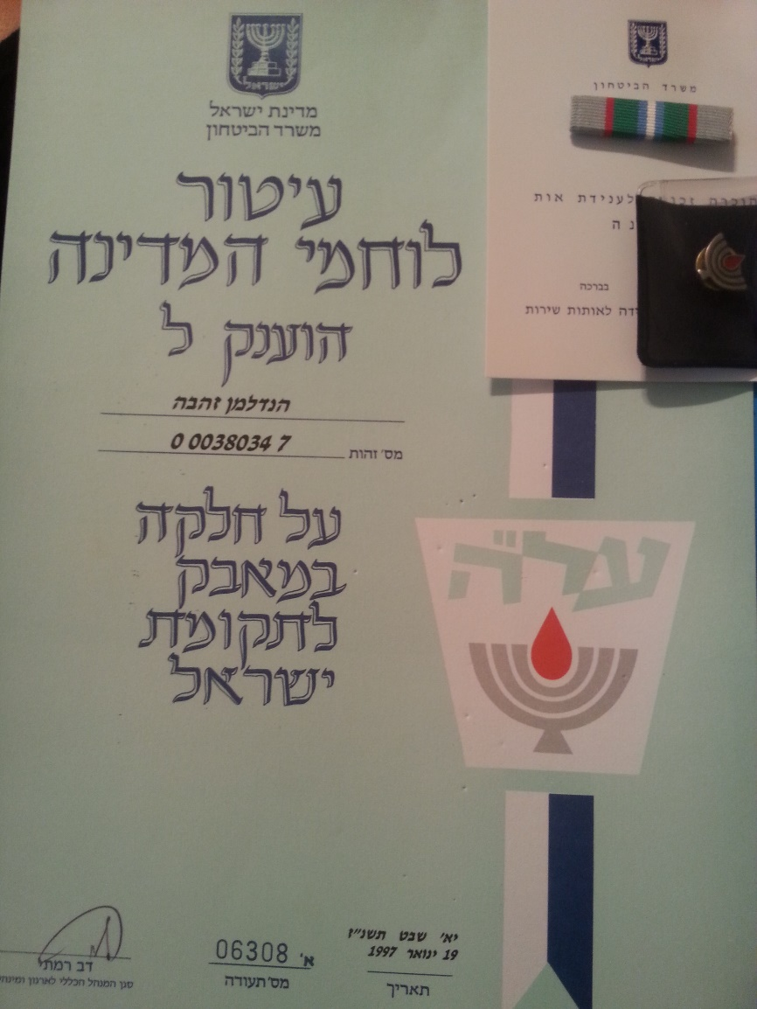
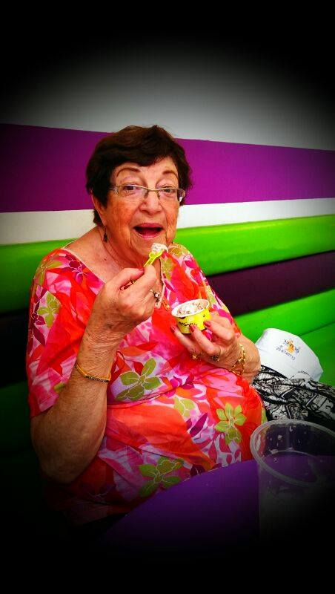
Before the establish of Israel
Active part in the fight for independence.
The Hagana law stated that its lines were open to:
"Every Jewish male or female, who is prepared and trained to fulfil the obligation of national defence."

Slide 4
1948-80’
variety of technical and administrative support roles

Slide 5
https://www.youtube.com/watch?v=GZ_ChidNOPM

Slide 6
1995- Alice miller’s petition

Slide 7
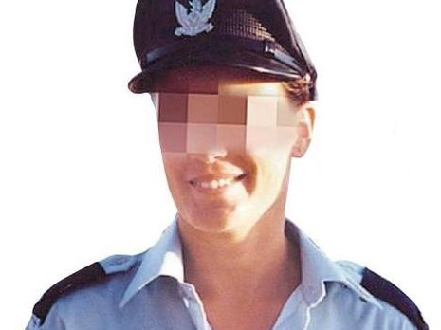
Yitzhak ‘Antek’ Zuckerman-
Warsaw Ghetto Uprising leader
Roni Zuckerman-
The first female fighter pilot

Slide 8
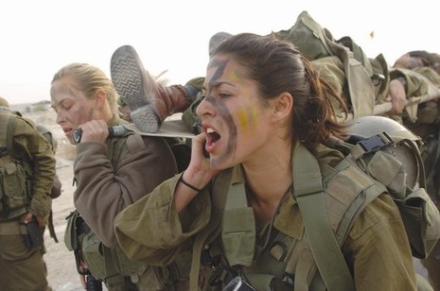
What has changed?
3 years instead of 2
Reserve duty until the age of 45
14 units open their gates to woman
92% of the roles in the army are open to woman

Slide 9
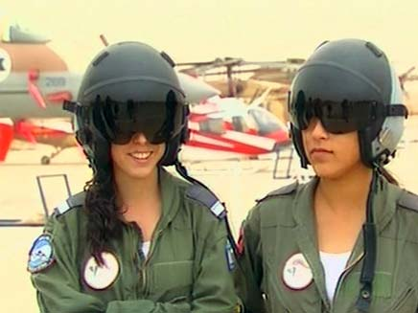
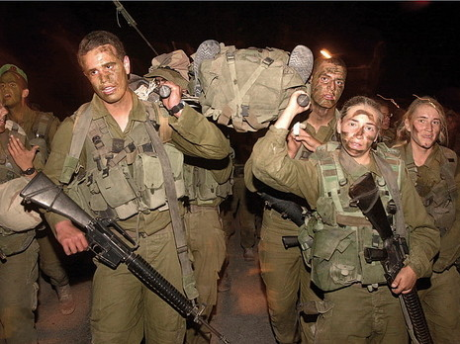
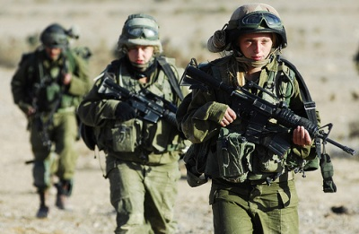
Combat units
2.2% of woman in the army
2.8% of warriors in the army

Slide 10
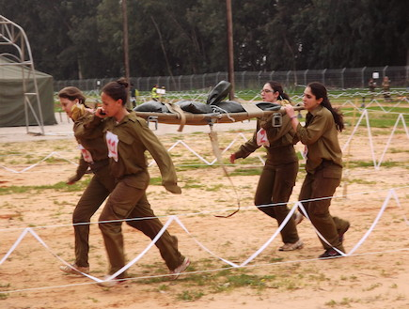
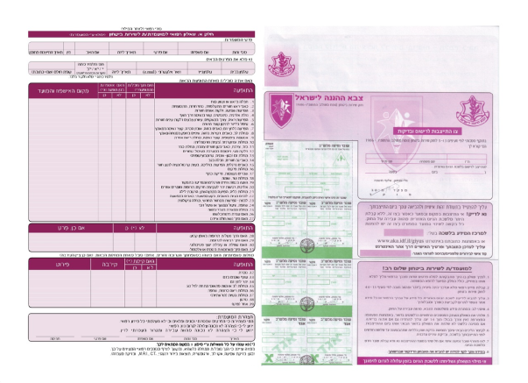
Chav Rishon

Slide 11
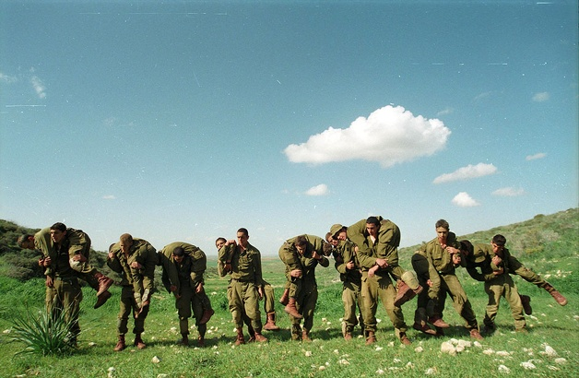
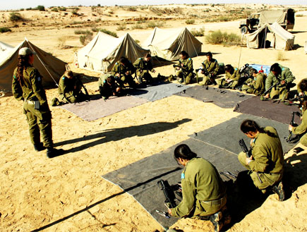
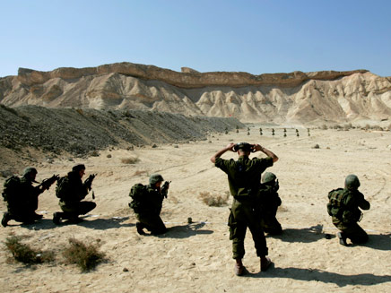

Slide 12
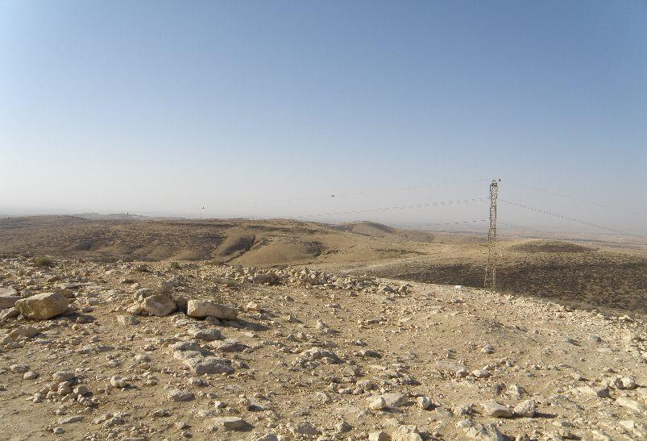

Slide 13
https://www.youtube.com/watch?v=8CQcflwGnyA

Slide 14
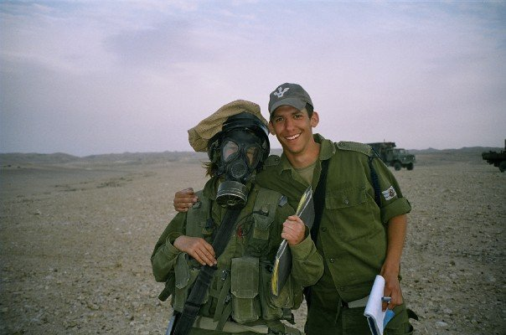

Slide 15
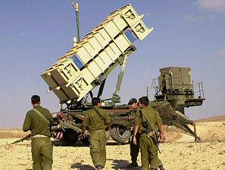
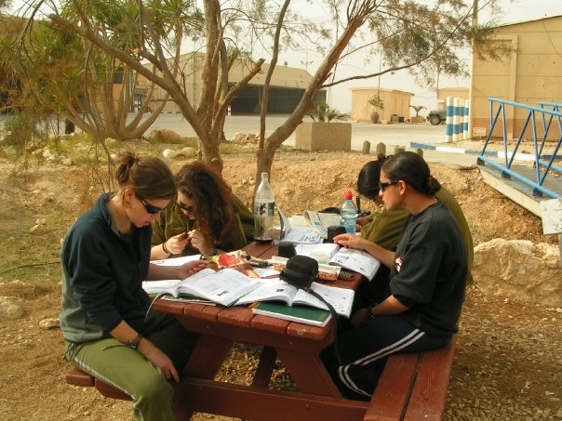

Slide 16
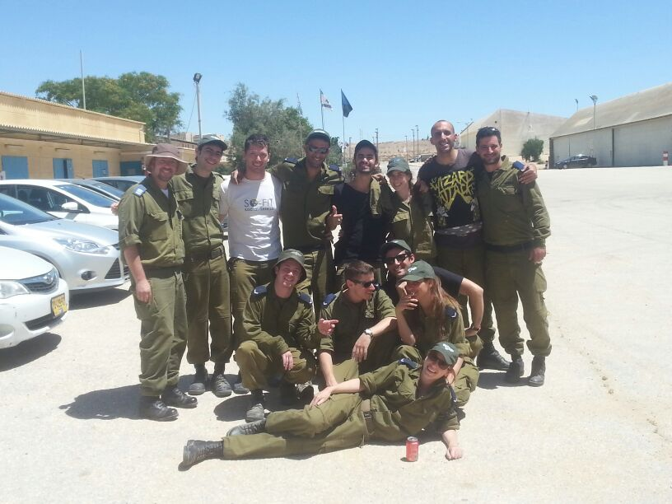
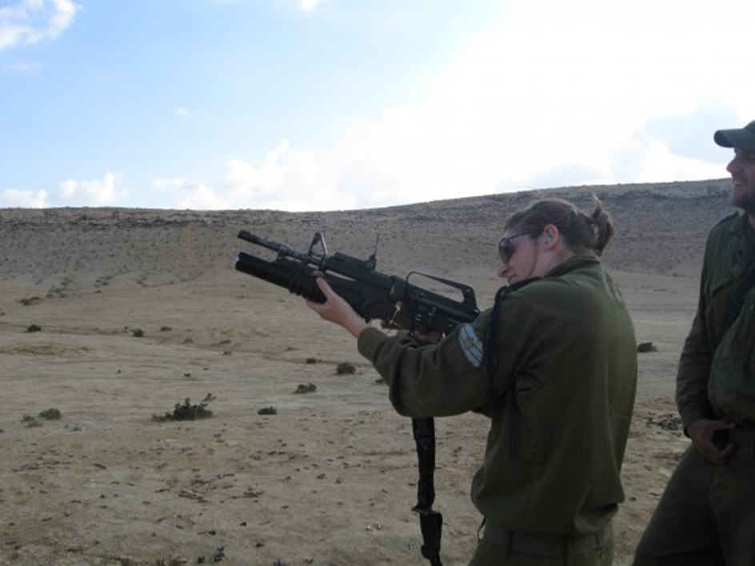

Slide 17
https://www.youtube.com/embed/o4kjNIL8prM

Slide 18
